Slide 1
St. Oscar Romero and
Liberation Theology
Dr. Cavender-McCoy

Slide 2
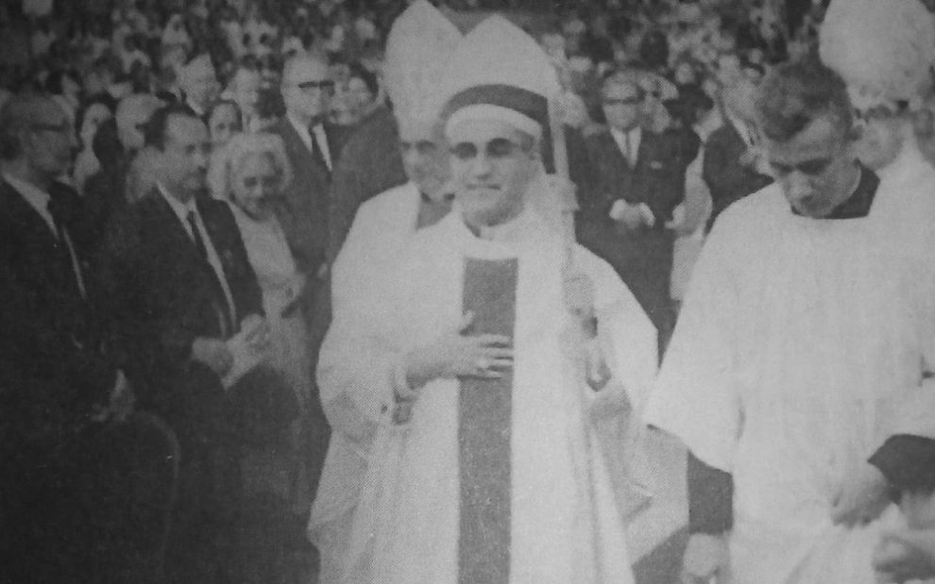
St. Oscar Romero
Notes:
On the evening of 24 March 1980, Archbishop Óscar Arnulfo Romero stood at the altar of the Chapel of Divine Providence in San Salvador. He had just finished a homily on the grain of wheat that must fall into the ground and die. As he turned toward the altar to continue the Mass, a single rifle shot struck him in the chest. He died at the offertory. The next day more than 100,000 people gathered for his funeral; many were shot by security forces. Romero’s blood was mixed with the blood of the poor he had defended.
This death is not merely a political assassination. It is a theological event. It crystallizes a major development in twentieth-century Catholic theology: the emergence of Latin American liberation theology and its claim that the preferential option for the poor is not an optional pastoral preference but a constitutive dimension of Christian faith.

Slide 3


Slide 4
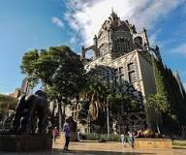
Liberation theology arose in the 1960s and 1970s in Latin America against the background of:
Extreme inequality
Military dictatorships and systematic repression
The Second Vatican Council (1962–65)
The 1968 Latin American Bishops’ Conference at Medellín, Colombia
Notes:
Liberation theology arose in the 1960s and 1970s in Latin America against the background of:
- Extreme inequality (in El Salvador a few dozen families controlled most of the land and wealth).
- Military dictatorships and systematic repression.
- The Second Vatican Council (1962–65), especially *Gaudium et Spes*, which declared that “the joy and hope, the grief and anguish of the people of our time, especially those who are poor or afflicted in any way, are the joy and hope, grief and anguish of the followers of Christ as well.”
- The 1968 Latin American Bishops’ Conference at Medellín, Colombia, which named “institutionalized violence” and called the Church to a preferential option for the poor.
Gustavo Gutiérrez’s *A Theology of Liberation* (1971) gave the movement its classic formulation. Other major voices included Leonardo Boff, Jon Sobrino, Juan Luis Segundo, and Ignacio Ellacuría. Romero was not the first theoretician, but he became its most visible pastoral embodiment and, after his death, one of its most powerful symbols. This is a major movement in Catholicicsm that is non-European!

Slide 5
Liberation Theology
The Preferential Option for the Poor
Reading the ‘signs of the times’
Integral liberation
Notes:
Liberation theology is best understood through three interlocking principles (drawn from both Gutiérrez and later interpreters who read Romero):
1. **The preferential option for the poor**
God is not neutral. The God of the Exodus, the prophets, and Jesus takes the side of the oppressed. The poor are not simply objects of charity; they are a *locus theologicus*—a privileged place where God is encountered. “The glory of God is the living person,” Irenaeus said; Romero and the liberation theologians specify: the glory of God is the living poor person. Poverty that kills is not a natural fact; it is the product of sinful structures.
2. **Reading the “signs of the times”**
Theology is not done primarily from textbooks but from the concrete historical situation of the people. The classic method is “see–judge–act”:
- See: analyze the social reality (often using tools of social science, including, controversially, elements of Marxist analysis of class and structural injustice).
- Judge: interpret that reality in the light of Scripture and tradition.
- Act: commit to transformative praxis.
3. **Integral liberation**
Salvation is not postponed entirely to the afterlife. It includes liberation from sin in its personal, social, and structural dimensions. The Kingdom of God has already begun and must be anticipated in history through justice, human dignity, and the overcoming of oppression. At the same time, authentic liberation theology insists that political and economic liberation remains incomplete without conversion of heart and openness to transcendent salvation.
Base ecclesial communities (*comunidades eclesiales de base*) became the primary laboratory of this theology: small groups of poor Christians who read the Bible together, analyzed their situation, and organized for mutual support and social change.

Slide 6
Oscar Romero’s Life and Theology
Romero’s three years as archbishop were a living theology. Key elements:
The poor as the body of Christ. “There is no dichotomy between the image of God and the human person.”
Prophetic denunciation.
Nonviolence rooted in the cross. He rejected both the structural violence of the system and the guerrilla violence of the left. “We have never preached violence, except the violence of love… the violence that we must each do to ourselves to overcome selfishness.”
The political dimension of faith.
Martyrdom as testimony.
Notes:
Biographical sketch
Born 15 August 1917 in Ciudad Barrios, El Salvador. Ordained in Rome in 1942. For decades he was regarded as a careful, even conservative priest and later auxiliary bishop. Appointed Archbishop of San Salvador in February 1977, many in the oligarchy and military hoped he would restrain more progressive clergy.
The conversion moment
Three weeks after his installation, his friend Fr. Rutilio Grande, S.J., was assassinated together with two companions while driving to a rural community. Grande had organized peasants and spoken against injustice. Romero later said, in substance: “If they killed him for what he was doing, then I too must walk the same path.” He suspended Masses in the cathedral except for Grande’s funeral, demanded an investigation, and began a public confrontation with the regime that never ceased.
Romero’s theological vision in practice
Romero’s three years as archbishop were a living theology. Key elements:
The poor as the body of Christ. He repeatedly insisted that to torture, disappear, or starve a human being is to assault the image of God. “There is no dichotomy between the image of God and the human person.”
Prophetic denunciation. His Sunday homilies, broadcast by radio, named the disappeared, the tortured, and the murdered. He became “the voice of the voiceless.”
Nonviolence rooted in the cross. He rejected both the structural violence of the system and the guerrilla violence of the left. “We have never preached violence, except the violence of love… the violence that we must each do to ourselves to overcome selfishness.”
The political dimension of faith. In his famous 1980 address at the University of Louvain he argued that the preferential option for the poor inevitably has political consequences because politics decides who lives and who dies. Yet the Church’s mission is not to become a political party; it is to evangelize the political realm from the standpoint of the Gospel.
Martyrdom as testimony. Romero understood that fidelity to the poor could cost his life. The night before his assassination he told the military: “I order you in the name of God: stop the repression.”
Romero did not write systematic treatises. His theology is found in pastoral letters, homilies, and the diary of a pastor who was being converted by the suffering of his people. Scholars such as Jon Sobrino and Michael Lee argue that this pastoral theology is liberation theology in its most evangelical form: grounded in revelation, the tradition, and the magisterium, yet radically responsive to the crucified peoples of Latin America.

Slide 7
Liberation Theology and the Vatican
Liberation theology is not a rupture with Catholic tradition but a development of several long-standing trajectories:
The biblical theme of the God who hears the cry of the poor (Exodus, Amos, Luke’s Magnificat and Nazareth manifesto).
The social encyclicals from Rerum Novarum onward.
Vatican II’s turn to the modern world and the Church as “people of God.”
Medellín and later Puebla’s explicit preferential option for the poor.
Two key documents:
1984 Instruction on Certain Aspects of the “Theology of Liberation”: warned against uncritical adoption of Marxist analysis, reduction of salvation to this-worldly liberation, class struggle as the primary hermeneutic, and any tendency to subordinate the Church’s hierarchical structure to base communities. It did not reject the preferential option for the poor.
1986 Instruction on Christian Freedom and Liberation: more positive, affirming the legitimate aspirations for justice and even, under strict conditions, the right to armed resistance against prolonged tyranny, while insisting that true liberation is first of all liberation from sin and openness to God.
Notes:
Liberation theology is not a rupture with Catholic tradition but a development of several long-standing trajectories:
The biblical theme of the God who hears the cry of the poor (Exodus, Amos, Luke’s Magnificat and Nazareth manifesto).
The social encyclicals from Rerum Novarum onward.
Vatican II’s turn to the modern world and the Church as “people of God.”
Medellín and later Puebla’s explicit preferential option for the poor.
At the same time it introduced genuine novelties: the methodological priority of praxis, the use of social-scientific analysis (including Marxist categories), and the claim that the poor are a privileged theological subject.
Vatican response under John Paul II and Cardinal Ratzinger (CDF)
Two key documents:
1984 Instruction on Certain Aspects of the “Theology of Liberation”: warned against uncritical adoption of Marxist analysis, reduction of salvation to this-worldly liberation, class struggle as the primary hermeneutic, and any tendency to subordinate the Church’s hierarchical structure to base communities. It did not reject the preferential option for the poor.
1986 Instruction on Christian Freedom and Liberation: more positive, affirming the legitimate aspirations for justice and even, under strict conditions, the right to armed resistance against prolonged tyranny, while insisting that true liberation is first of all liberation from sin and openness to God.
Pope Francis later rehabilitated the movement’s positive insights, beatified Romero in 2015, and canonized him in 2018, declaring him a martyr killed in odium fidei—out of hatred for the faith, precisely because he defended the poor as an expression of the Gospel.

Slide 8
The Legacy of Liberation Theology
Did some forms of liberation theology become too dependent on Marxist analysis and utopian politics?
How does one keep the eschatological reserve—the knowledge that no political order is the Kingdom—while still working for concrete justice?
What is the proper relationship between the hierarchical Church and grassroots communities?
In a post-Cold War, globalized world of migration, climate crisis, and new forms of inequality, what does a liberation theology look like today?
Notes:
Enduring contributions
The preferential option for the poor is now mainstream Catholic social teaching.
Greater attention to structural sin and the social dimension of salvation.
A model of prophetic episcopal leadership that prioritizes the marginalized.
Inspiration for theology from the underside of history (also influencing feminist, Black, Asian, and other contextual theologies).
Persistent criticisms and open questions
Did some forms of liberation theology become too dependent on Marxist analysis and utopian politics?
How does one keep the eschatological reserve—the knowledge that no political order is the Kingdom—while still working for concrete justice?
What is the proper relationship between the hierarchical Church and grassroots communities?
In a post-Cold War, globalized world of migration, climate crisis, and new forms of inequality, what does a liberation theology look like today?
Romero’s own answer was neither ideological nor abstract. He kept returning to the concrete person: the campesino, the mother searching for her disappeared son, the young man tortured. For him the criterion was always whether the Church was becoming more like the Good Shepherd who lays down his life for the sheep.
58–60 minutes: Closing
Close with Romero’s own words, spoken weeks before his death:
“I do not believe in death without resurrection. If they kill me, I will rise again in the Salvadoran people… A bishop will die, but the Church of God, which is the people, will never perish.”

Slide 9
Black Liberation Theology
Black liberation theology is a contextual Christian theology that emerged in the United States in the late 1960s. It interprets the gospel through the lived experience of Black people under racial oppression and asserts that God sides with the oppressed in the struggle for liberation.
Christianity is essentially a religion of liberation.
God is on the side of the oppressed.
“God is Black” / Christ is Black. This is not primarily a claim about skin color but an ontological and symbolic affirmation: God has taken the side of the oppressed. Jesus enters the world of the poor, the despised, and the Black, sharing their humiliation and transforming it. Cone later compared the crucifixion to a first-century lynching, underscoring divine solidarity with victims of racial terror.
Notes:
Black liberation theology is a contextual Christian theology that emerged in the United States in the late 1960s. It interprets the gospel through the lived experience of Black people under racial oppression and asserts that God sides with the oppressed in the struggle for liberation.
Origins and Historical Context
It arose during the Civil Rights and Black Power movements. Many Black clergy and scholars grew frustrated with the slow pace of change and with white Christianity’s frequent silence on, or complicity in, racism. A 1966 “Black Power” statement by Black ministers in the New York Times marked an early public affirmation that Black self-determination was compatible with the gospel.
James H. Cone (1938–2018), often called the founder or “father” of Black theology, systematized the movement. His books Black Theology and Black Power (1969) and A Black Theology of Liberation (1970) launched it as a formal theological discipline. Cone sought to reconcile the nonviolent Christian witness of Martin Luther King Jr. with the assertive self-determination associated with Malcolm X and Black Power.
Core Claims
Christianity is essentially a religion of liberation. Any theology indifferent to the oppression of the poor and marginalized is not truly Christian. Theology’s task is to analyze the meaning of liberation for the oppressed so they recognize their struggle as consistent with the gospel.
God is on the side of the oppressed. Drawing heavily on the Exodus narrative and the prophetic tradition, Cone argued that the God of the Bible is revealed as Liberator. In the American context of white racism, this means God identifies with Black people.
“God is Black” / Christ is Black. This is not primarily a claim about skin color but an ontological and symbolic affirmation: God has taken the side of the oppressed. Jesus enters the world of the poor, the despised, and the Black, sharing their humiliation and transforming it. Cone later compared the crucifixion to a first-century lynching, underscoring divine solidarity with victims of racial terror.
White theology and white Christianity are critiqued as often serving the interests of the oppressor. Traditional European-American theology is seen as having largely ignored or justified the suffering of Black people.
Method and Sources
Black theology begins with the Black experience of oppression as a primary source and norm, alongside Scripture, Black history and culture, and the Black church tradition. It is a “theology of and for the Black community,” seeking to interpret the religious dimensions of the struggle for freedom. Praxis—concrete action for justice—is central, not merely abstract reflection.
Relation to Other Liberation Theologies
It developed roughly simultaneously with Latin American liberation theology (e.g., Gustavo Gutiérrez’s A Theology of Liberation, 1971) but focused primarily on race and racism rather than class and economic structures. The two traditions later engaged in dialogue and share the conviction that God has a preferential option for the oppressed, though their social analyses and emphases differ.

