Slide 1
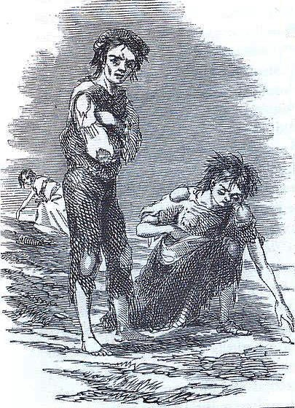
Irish Immigrant Mothers of Gynecology

Slide 2


Slide 3
Key Concepts:
Workhouse
The Great Famine 1845-1852
A Modest Proposal
Jonathan Swift
The Racial Imaginary
Irish Diaspora
Sisters of Mercy

Slide 4
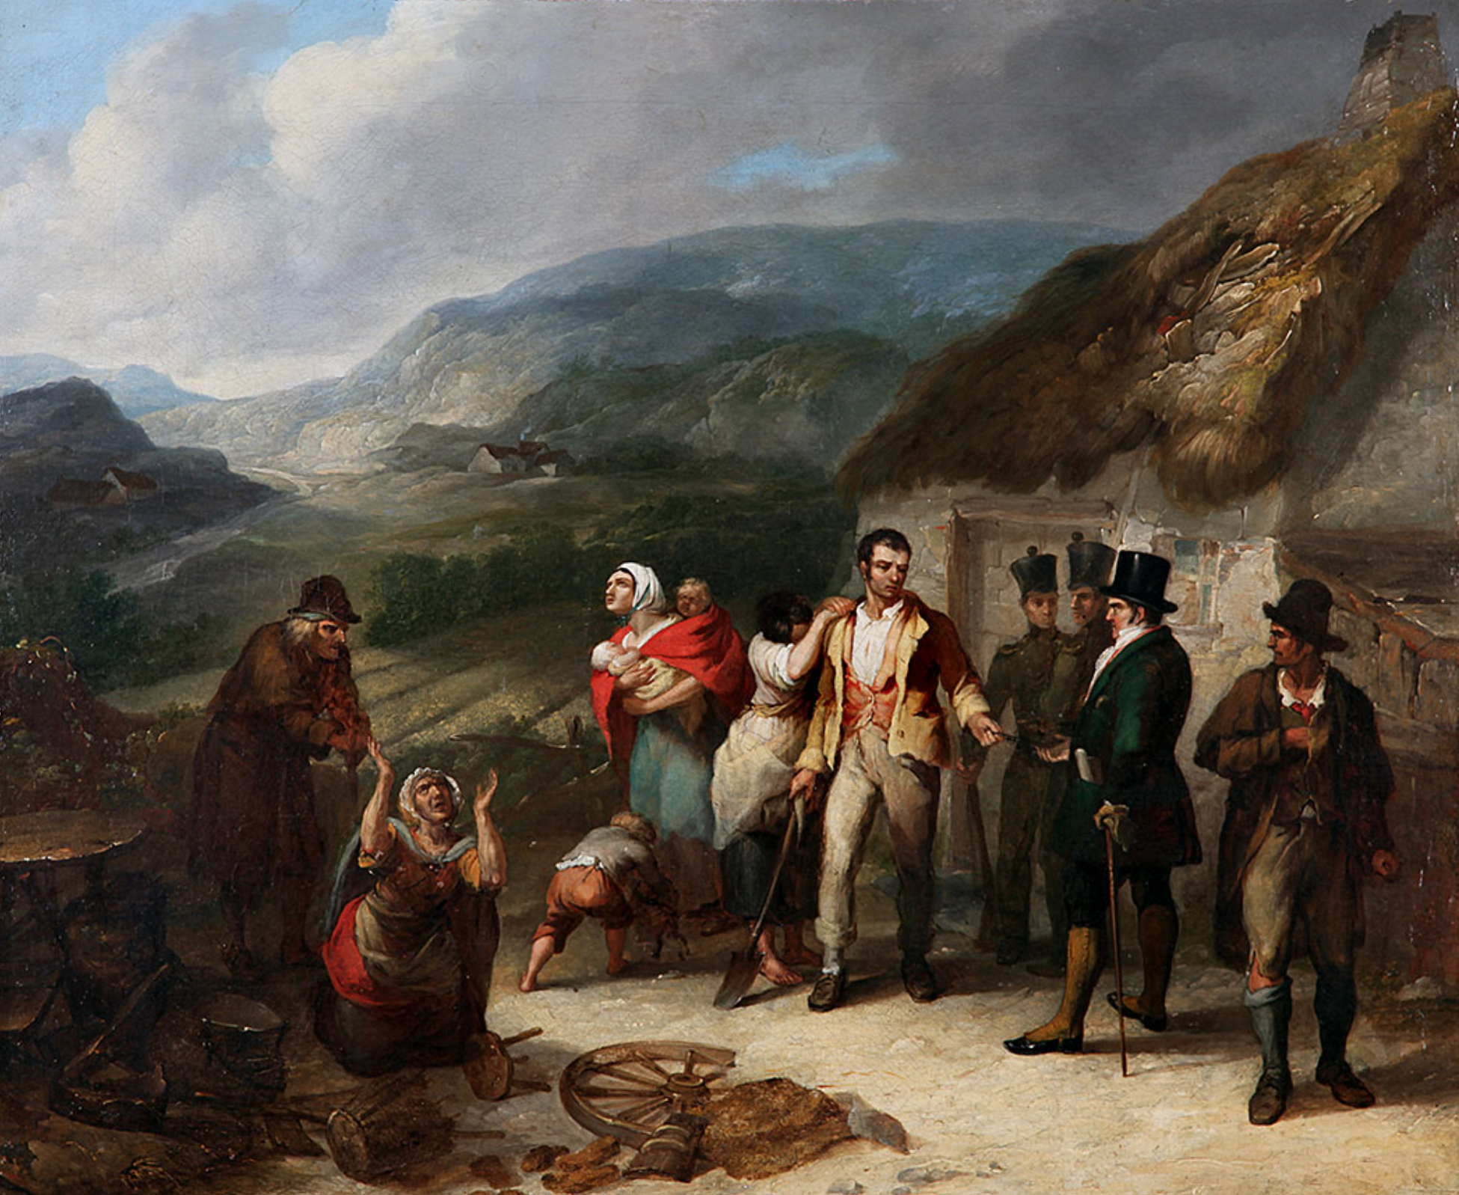
The Great Famine 1845-1852

Slide 5

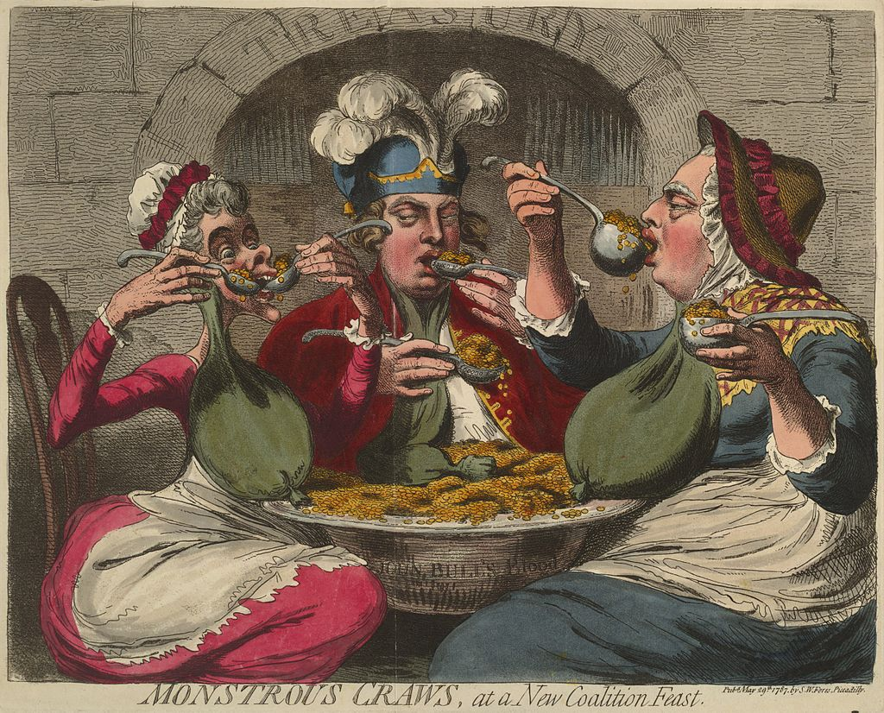

Slide 6
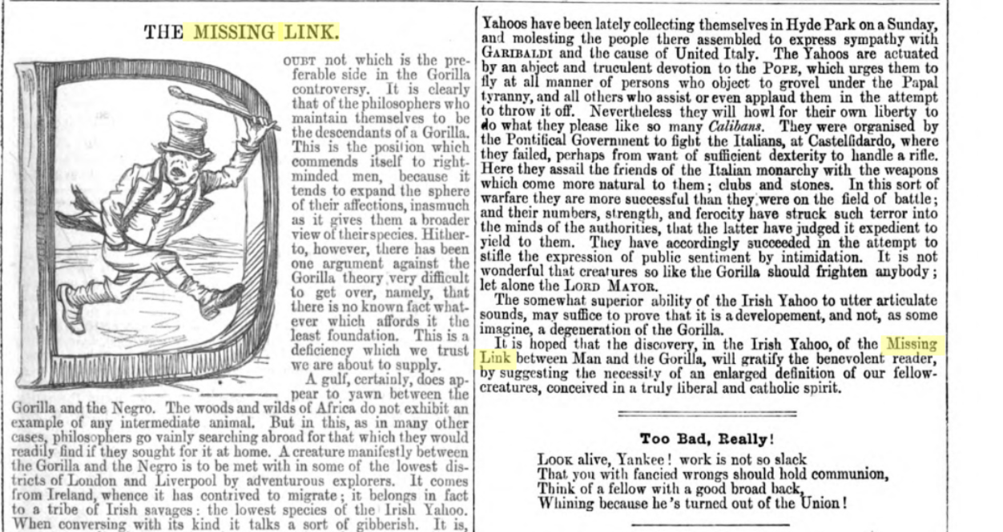

Slide 7


Slide 8
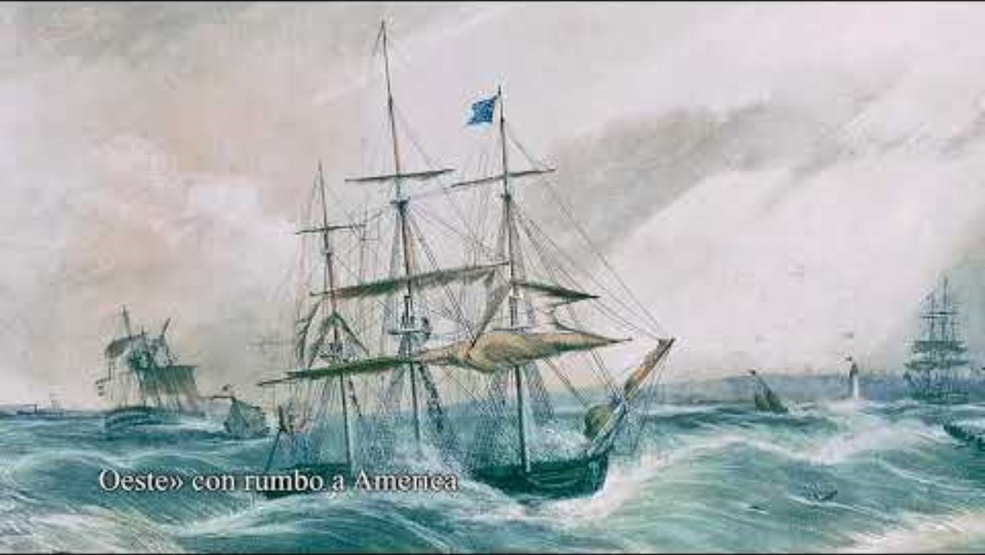

Slide 9
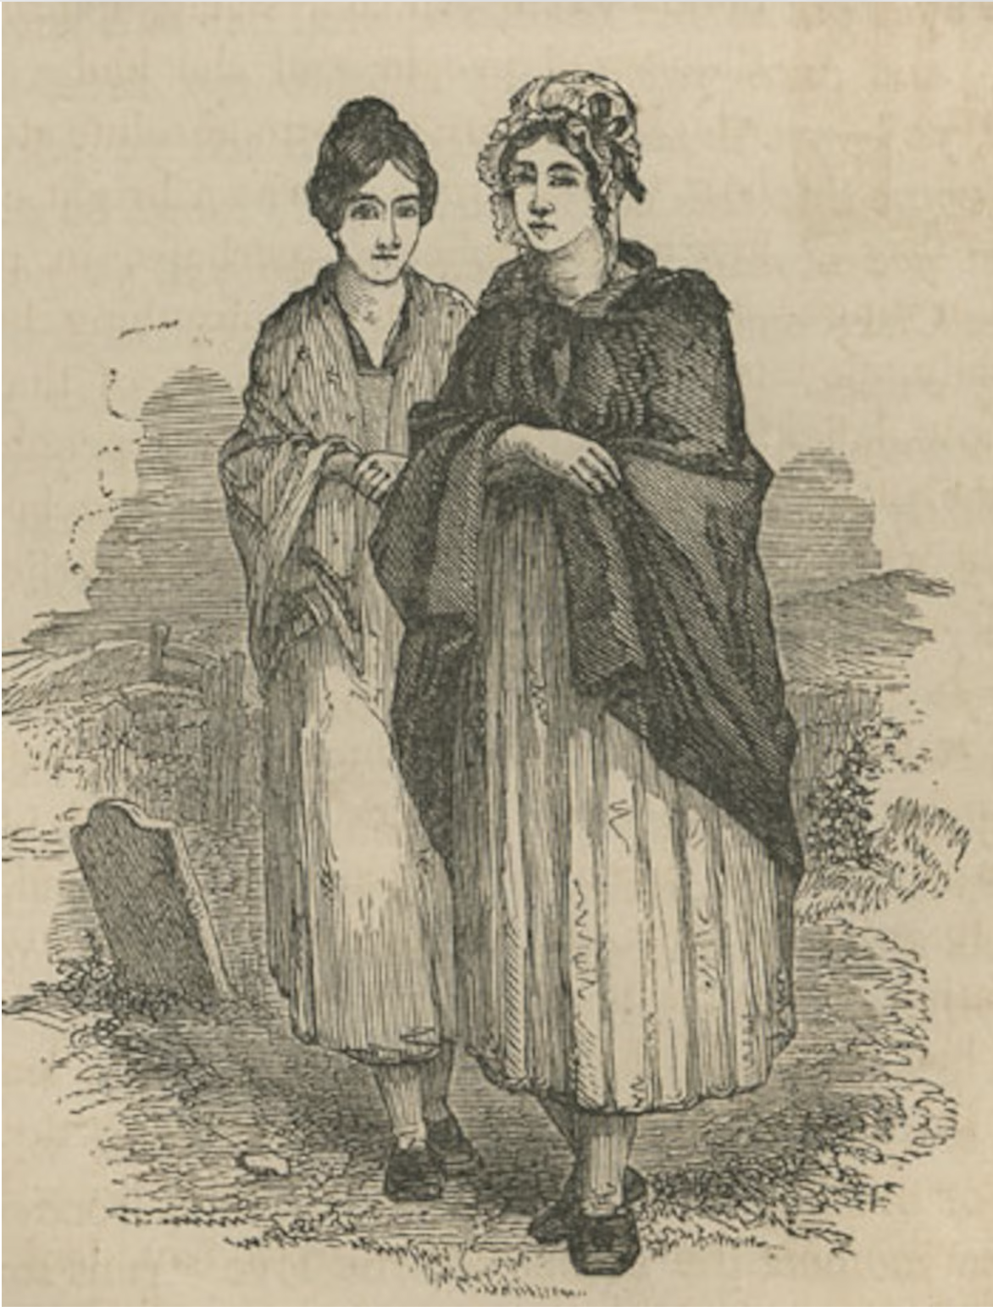
Curragh wrens

Slide 10
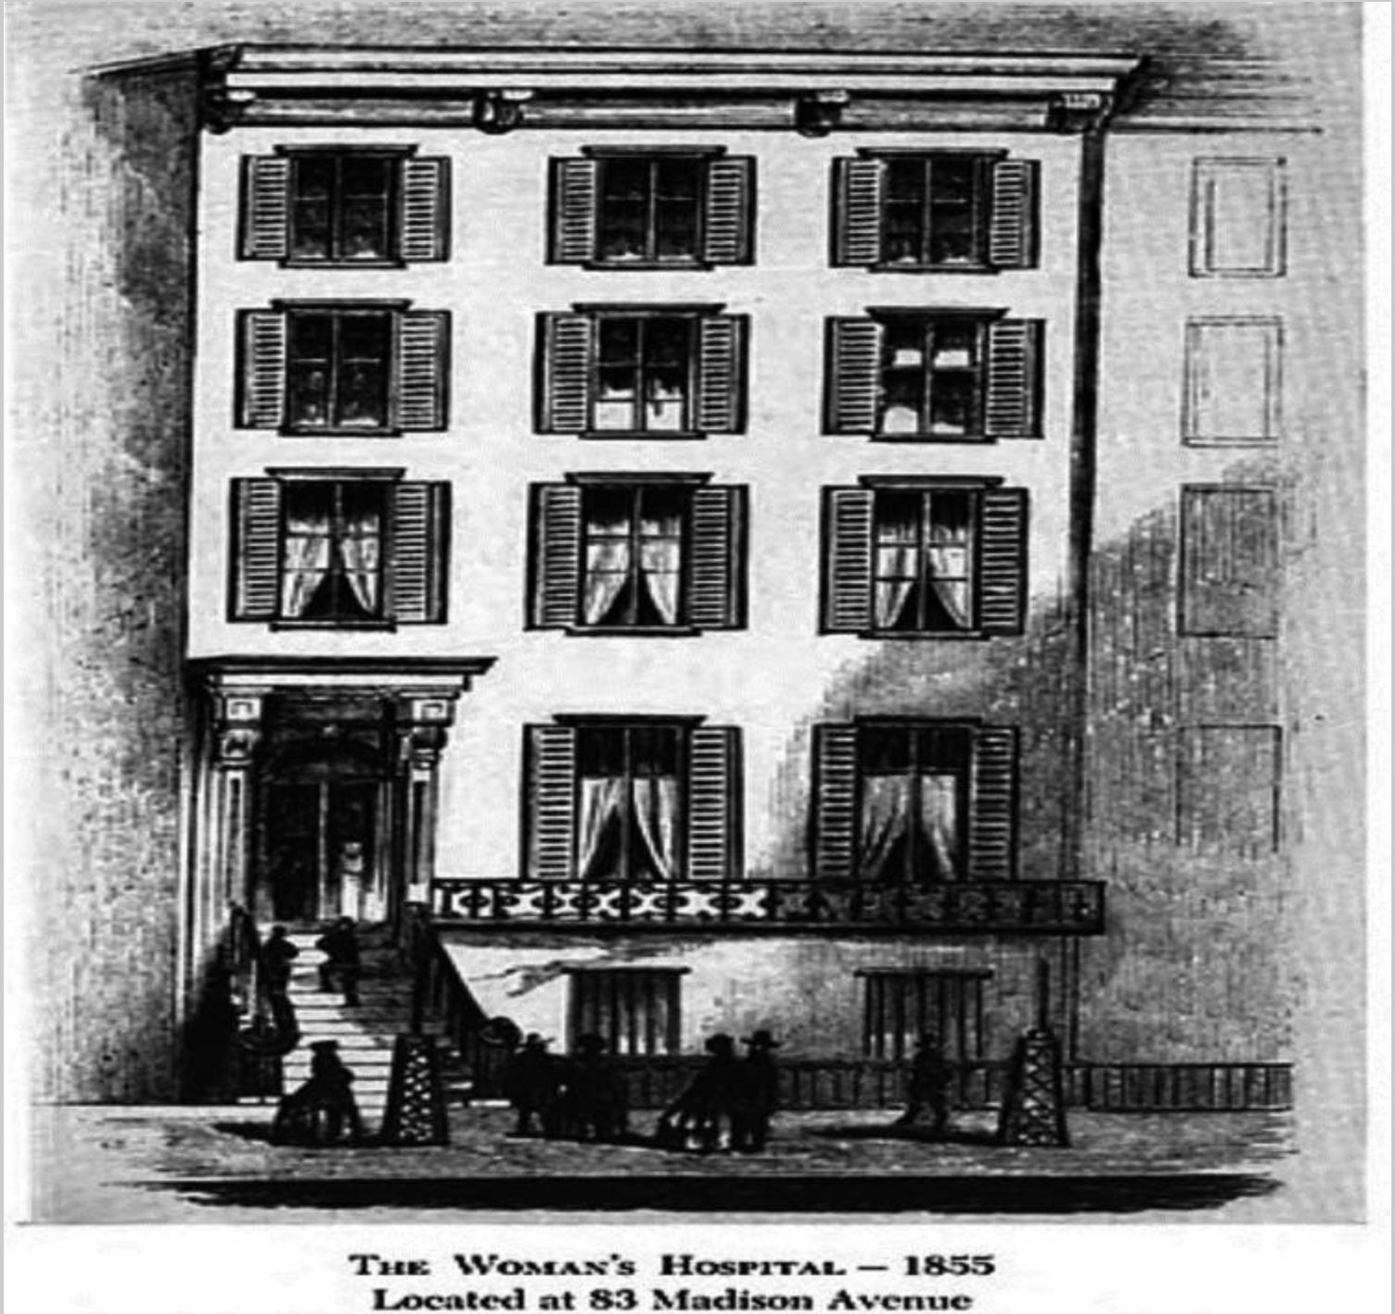

Slide 11

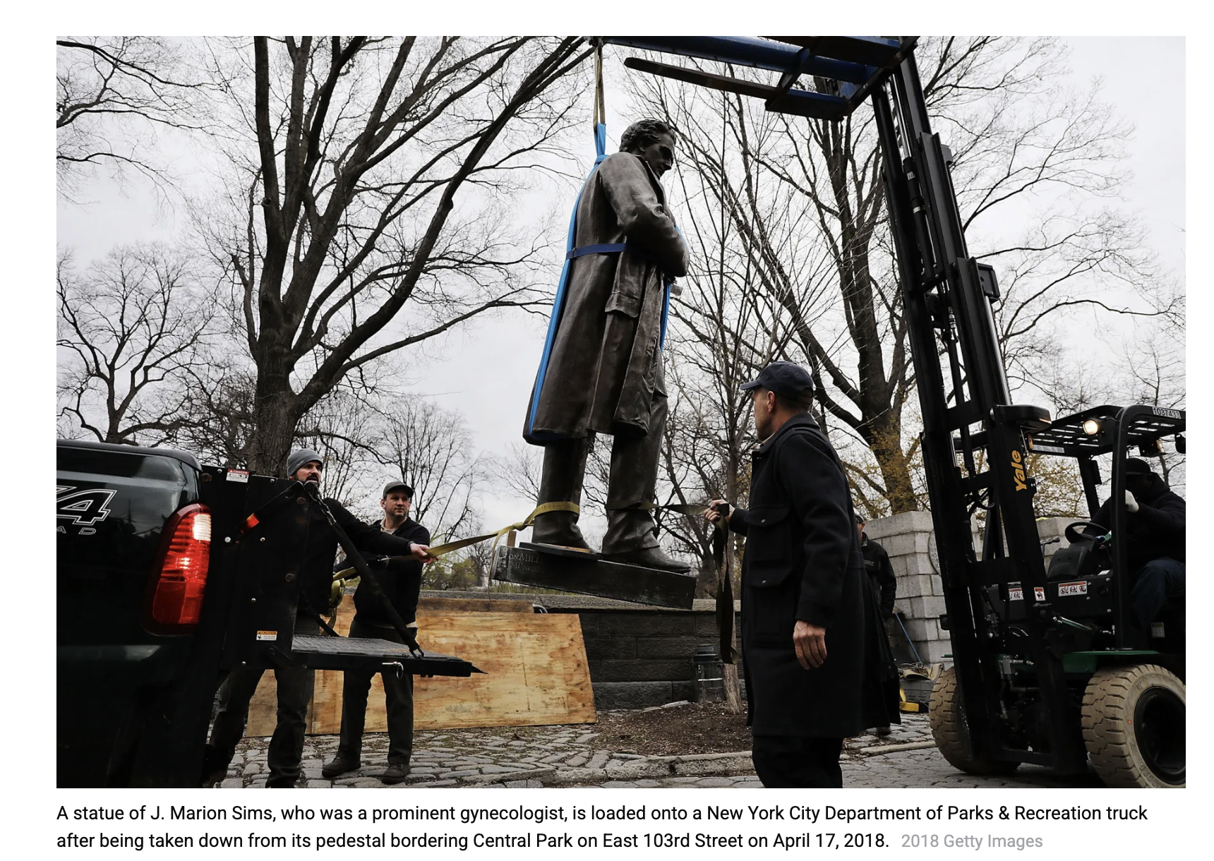

Slide 12
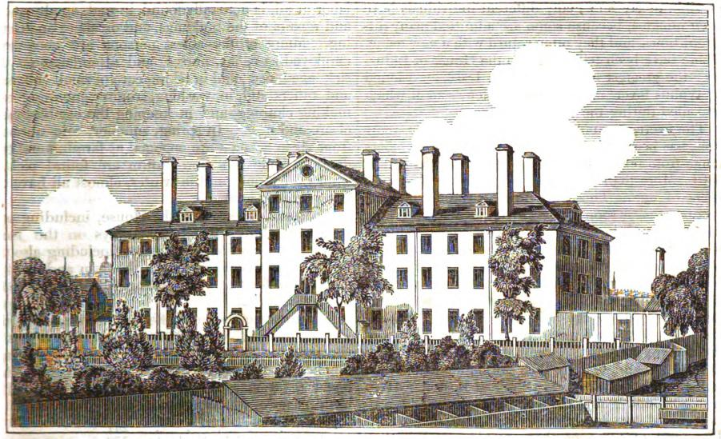
House of Industry: South Boston

