Slide 1


Slide 2
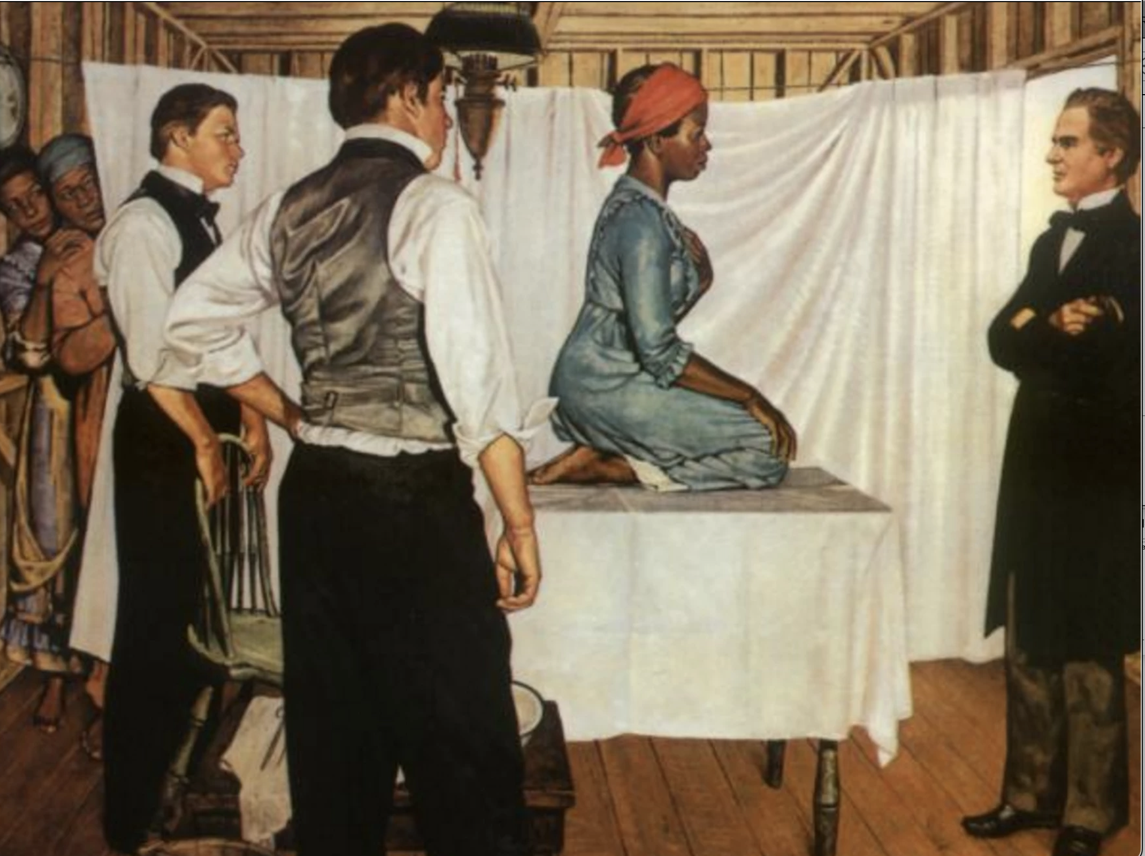
The Mothers of Modern Gynecology

Slide 3
Key Concepts:
Biological Racism
Slave Trade Act of 1807
Social Reproduction
Vaginal Fistula
James Marion Sims

Slide 4
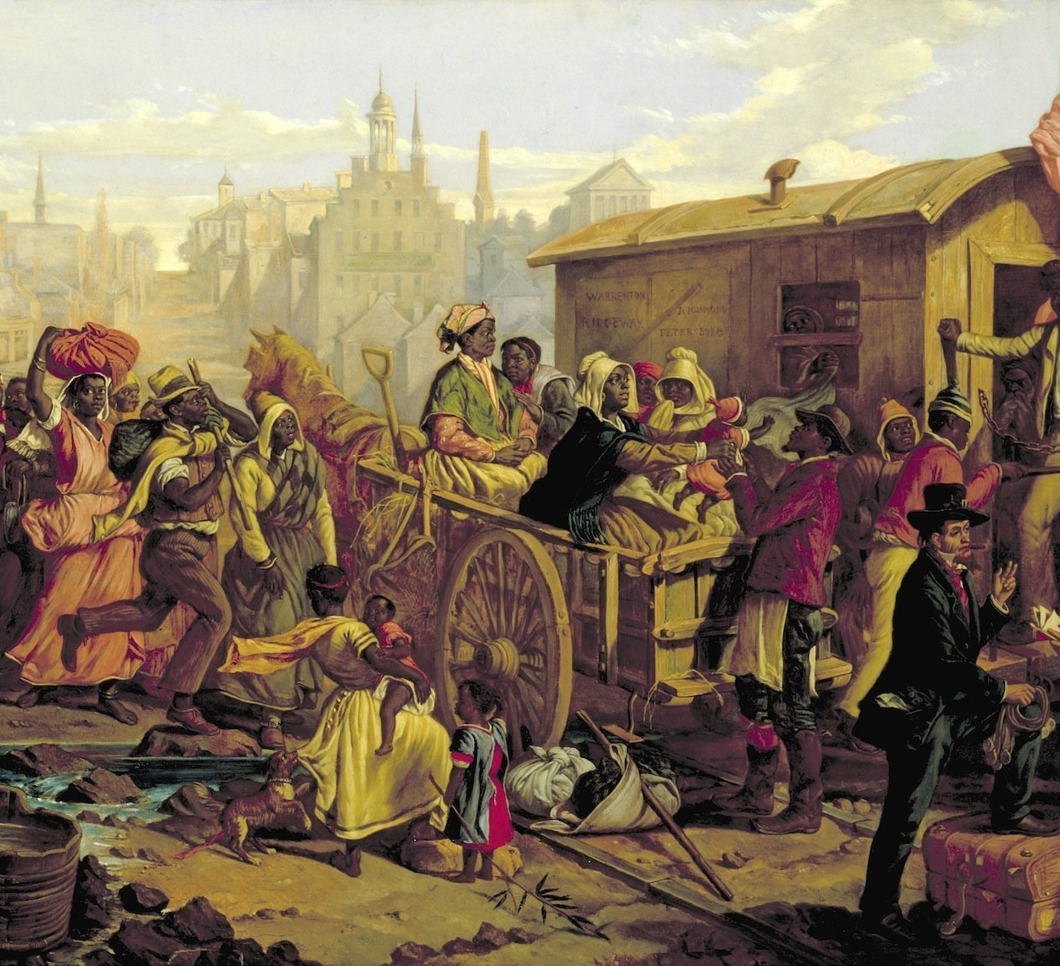
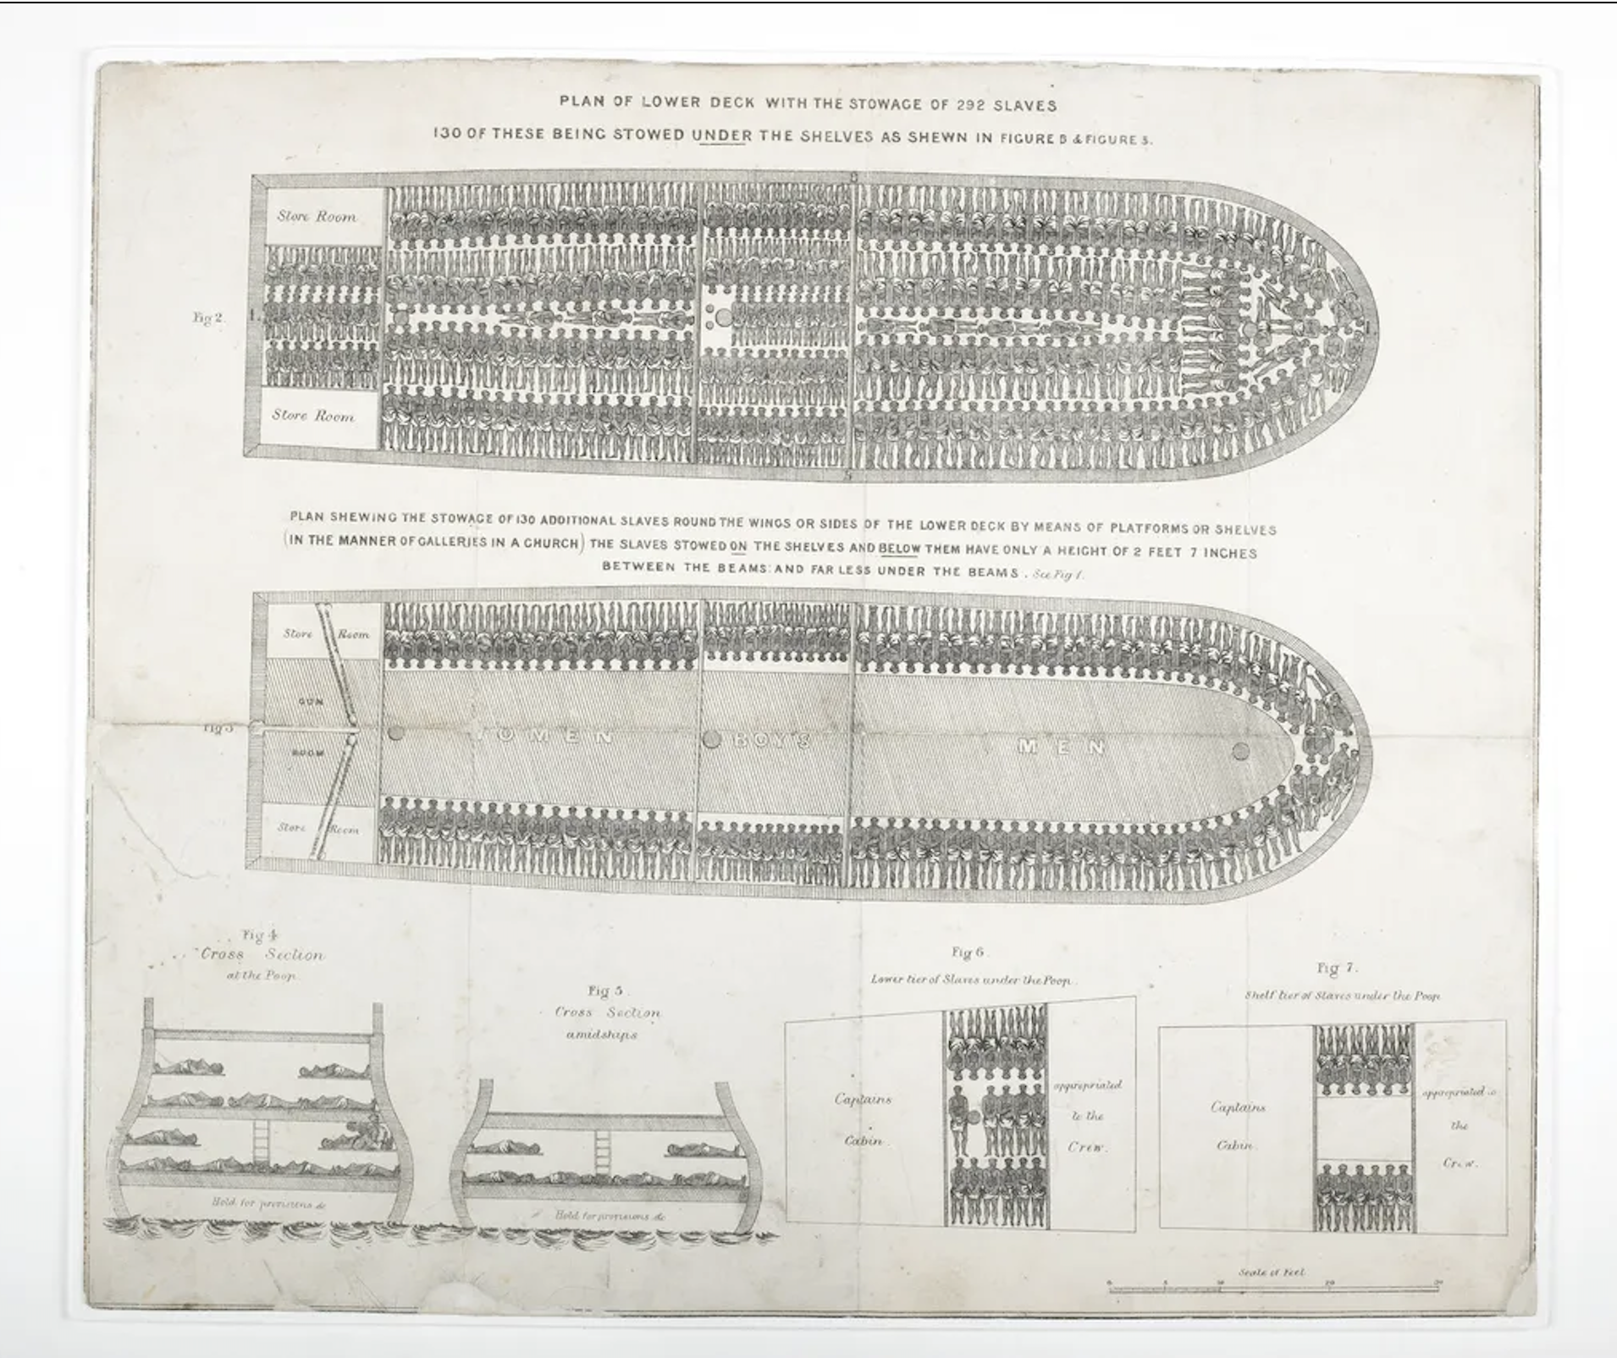
The End of the Transatlantic Slave Trade

Slide 5
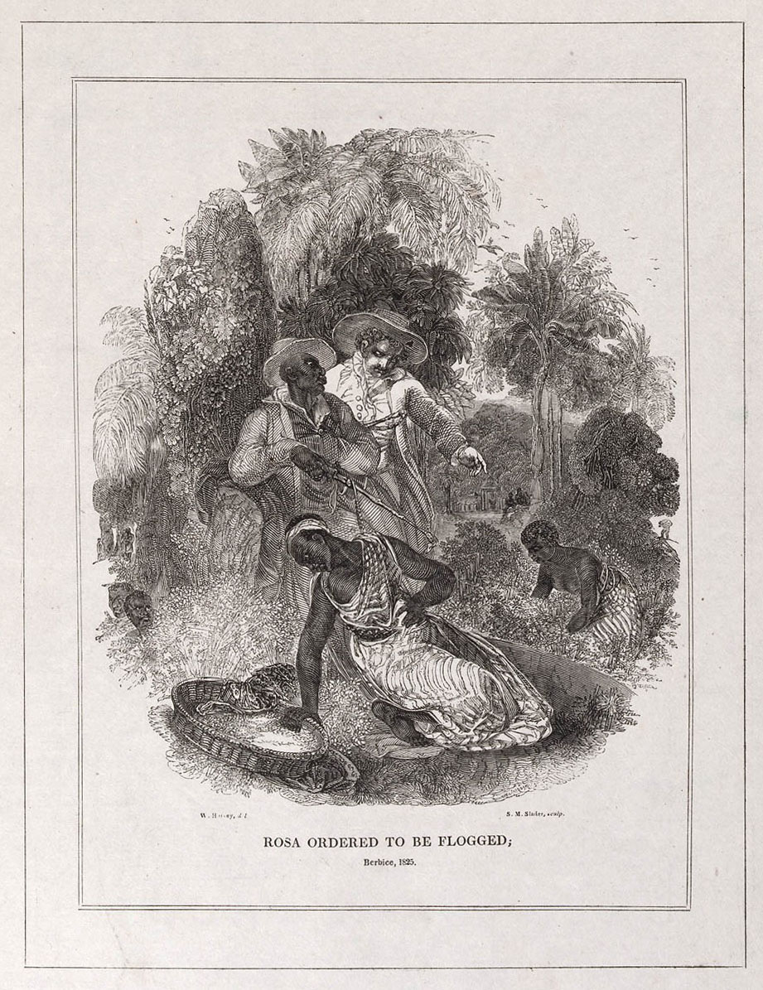
Social Reproduction
'Rosa Ordered to be Flogged'
Wood engraving by Slader after Harvey, and published by S.M. Slader. 1825. "The Miseries of Slavery". Royal Museums Greenwich.
"The reproduction of human beings is, in terms of economics, production of labour-power in all it's forms". - Claude Meillassoux, Maidens, Meal and Money

Slide 6
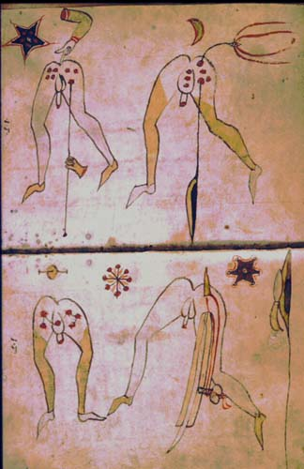
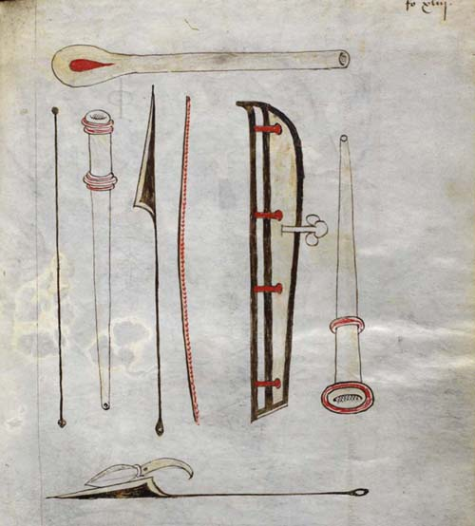
Fistula Treatments:
A Short History
Full page illustration of use of surgical instruments in operation for fistula-in-ano (folio 43v)
John of Arderne, "Treatises of fistula in ano, haemorrhoids, and clysters".
GLASGOW UNIVERSITY LIBRARY
SPECIAL COLLECTIONS DEPARTMENT

Slide 7
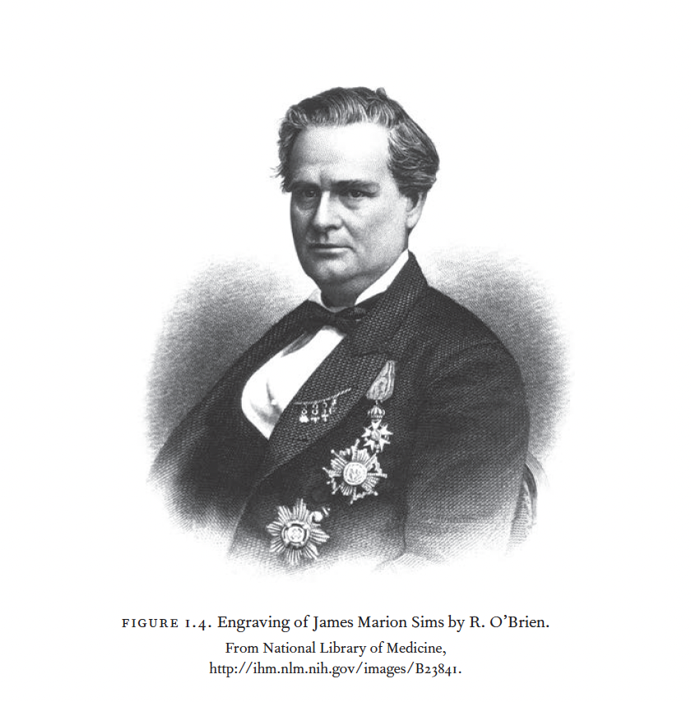
James Marion Sims (1813-1883)

Slide 8

Biological Racism & The Racial Supermen

Slide 9
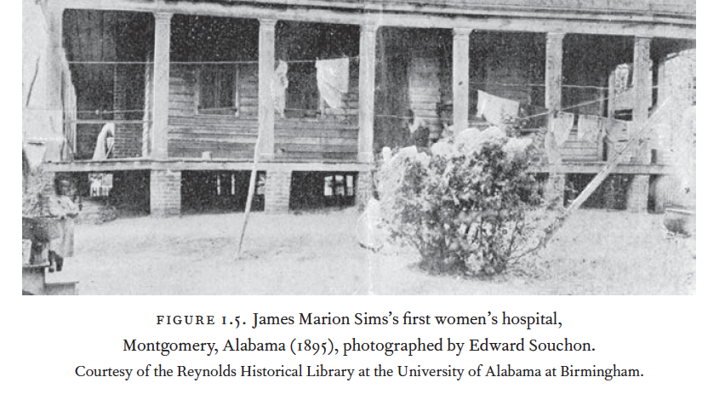

Slide 10

