Slide 1
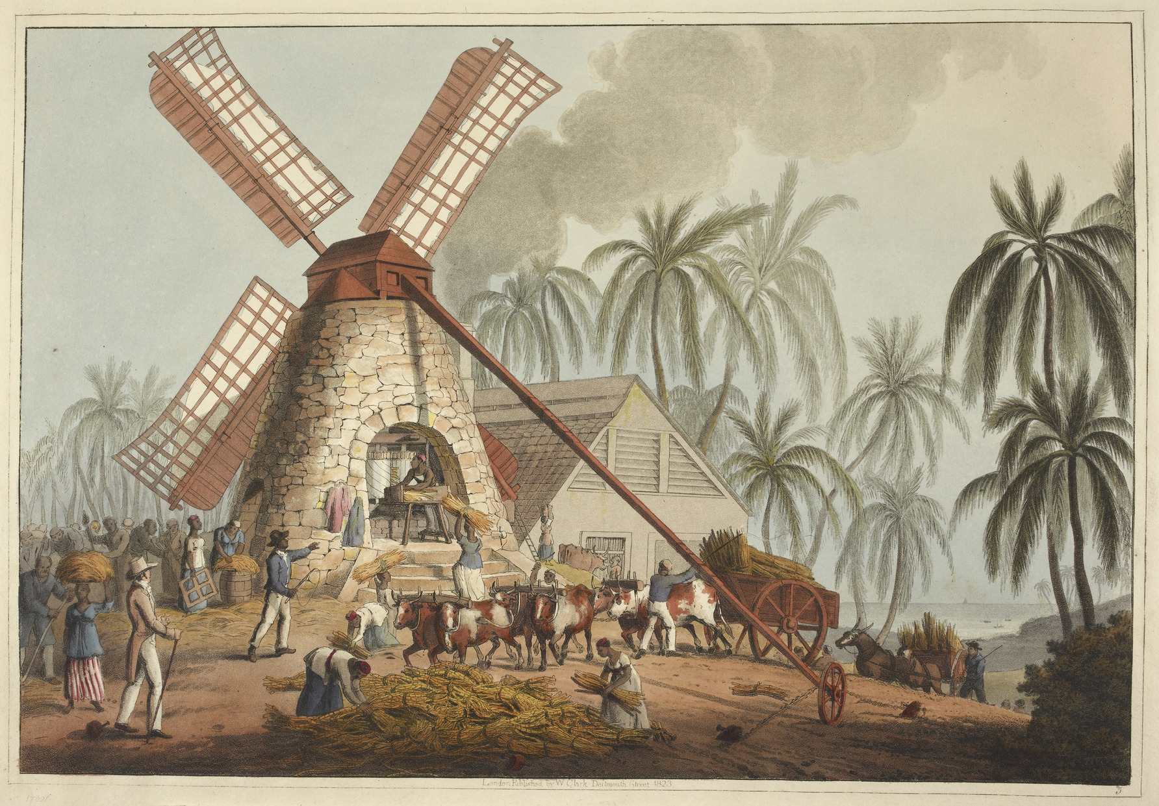
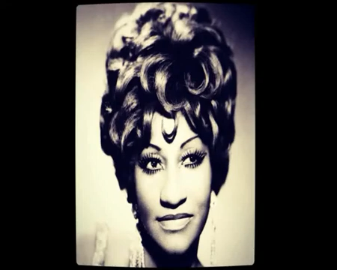
The Rise of Chattel Slavery in the West
Dr. Luz Christina Colpa
"Ten Views in the Island of Antigua, in Which Are Represented the Process of Sugar Making, and the Employment of the Negroes in the Field, Boiling-House, and Distillery". William Clark (1823).

Slide 2

"Whoever says industrial Revolution says cotton".
-Eric Hobsbawm

Slide 3




Slide 4
Key Concepts:
Social Death
Eric Hobsbawn
Chattel Slavery
Wenches/Signares
The “Barbados” or “Gang” System
War Capitalism

Slide 5
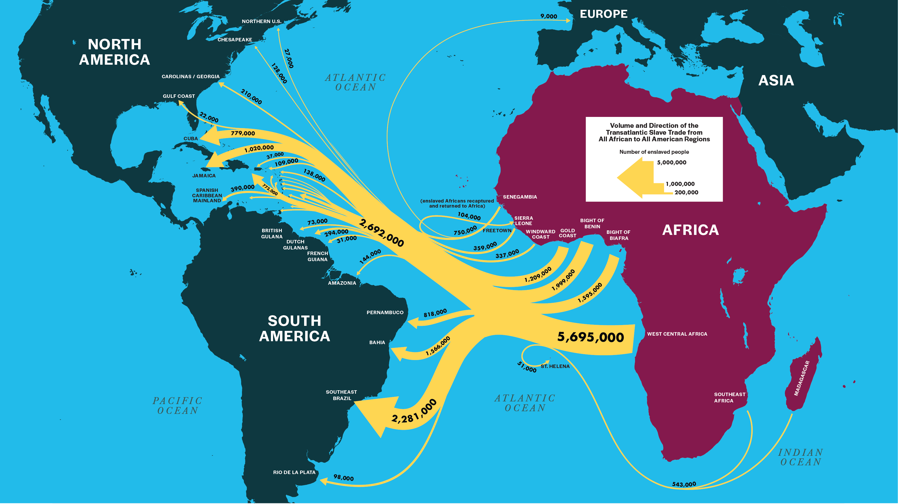
The transatlantic Slave trade

Slide 6


Slide 7
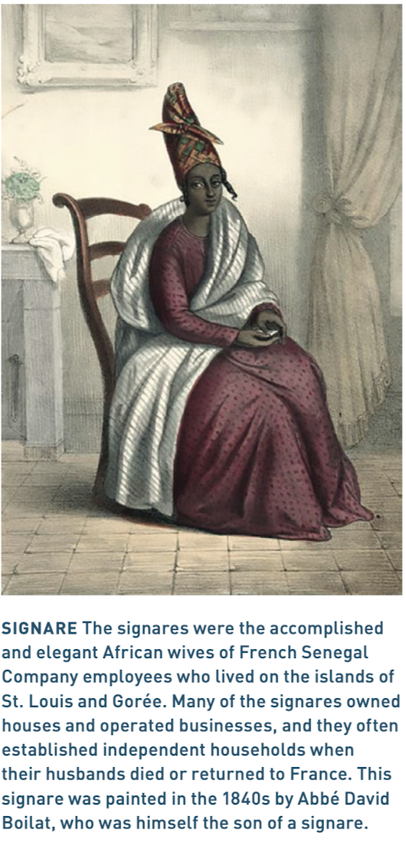
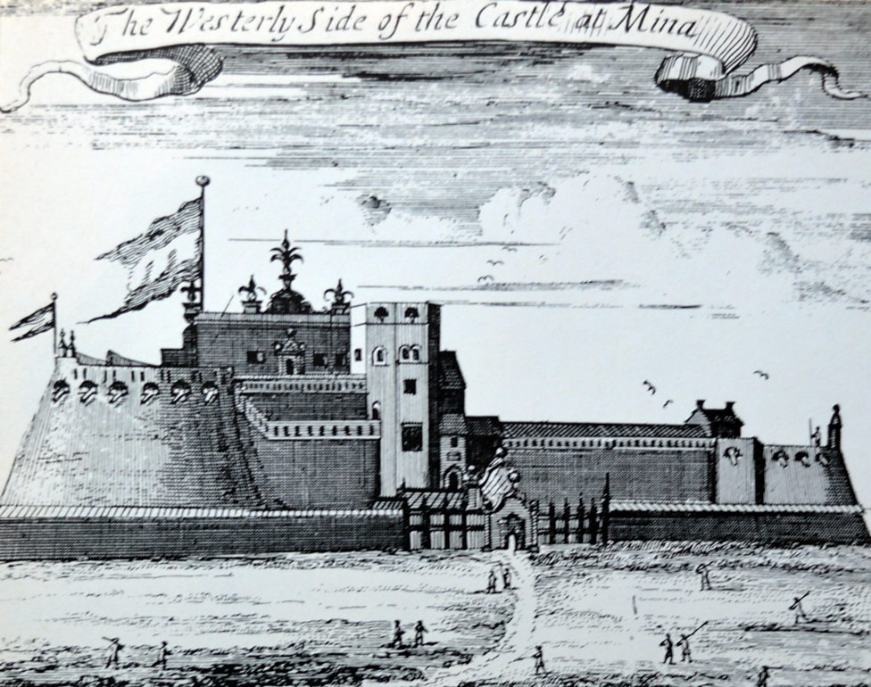
Homegoing, Chapter 1-
Effia

Slide 8
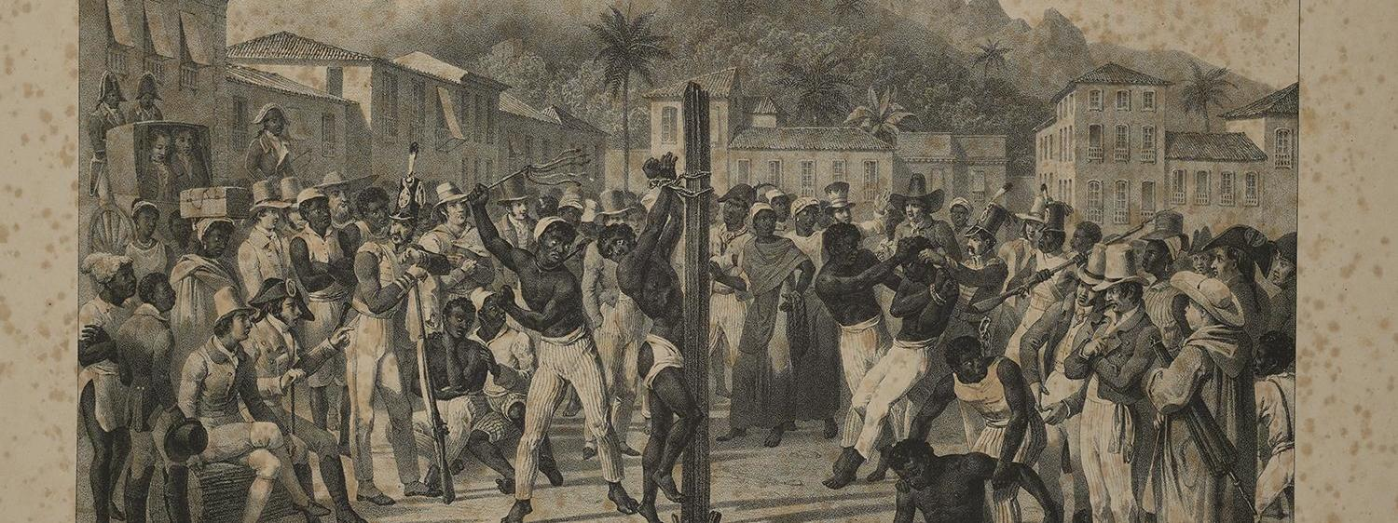
Slavery in the Carribean
Johann Moritz Rugendas, Voyage pittoresque dans le Brésil. Firestone Library. Brazillab Princeton.

Slide 9
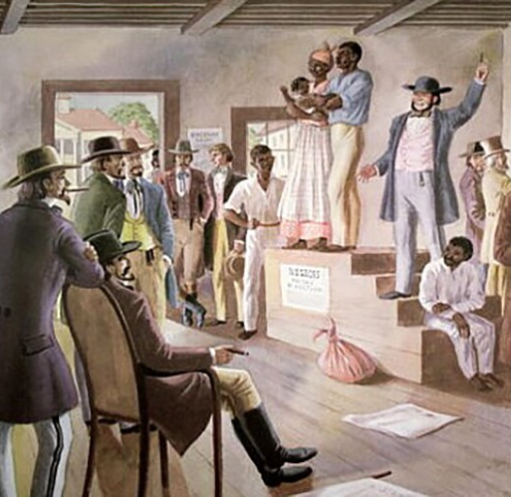
War Capitalism

