Slide 1
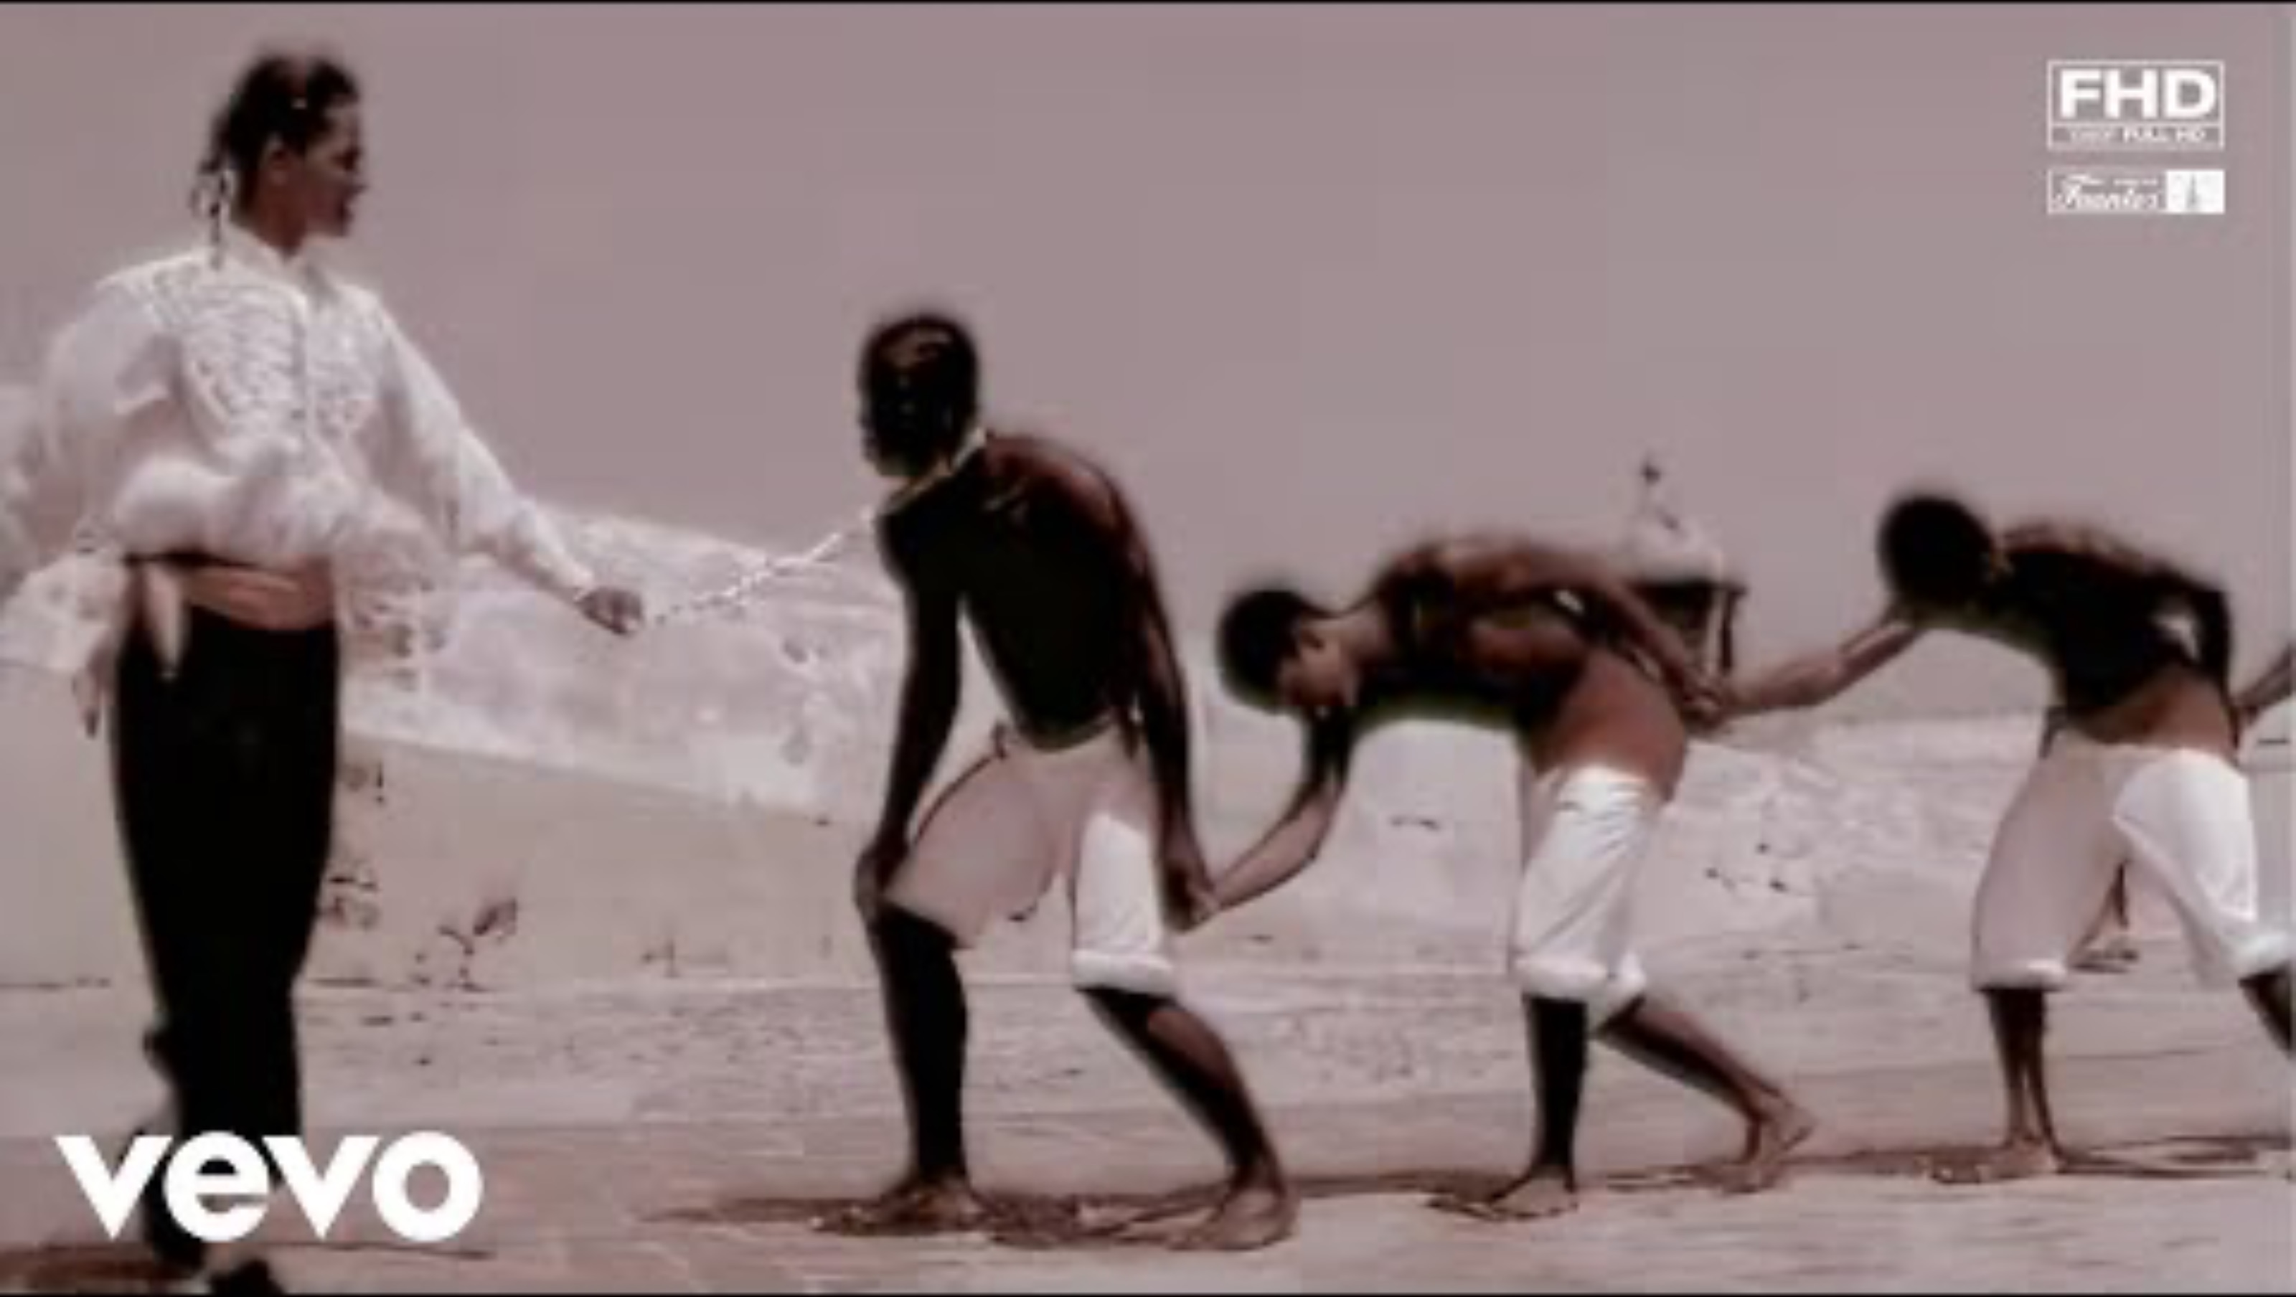
Global
Global Slavery
Dr. Luz Cristina Colpa

Slide 2

Joe Arroyo –
La Rebelión

Slide 3
Key Concepts:
Social Death
Characteristics of Enslavement
Chattel Vs. Domestic Slavery
Ahmed Baba
Hamitic Myth
Bartolomé de las Casas

Slide 4
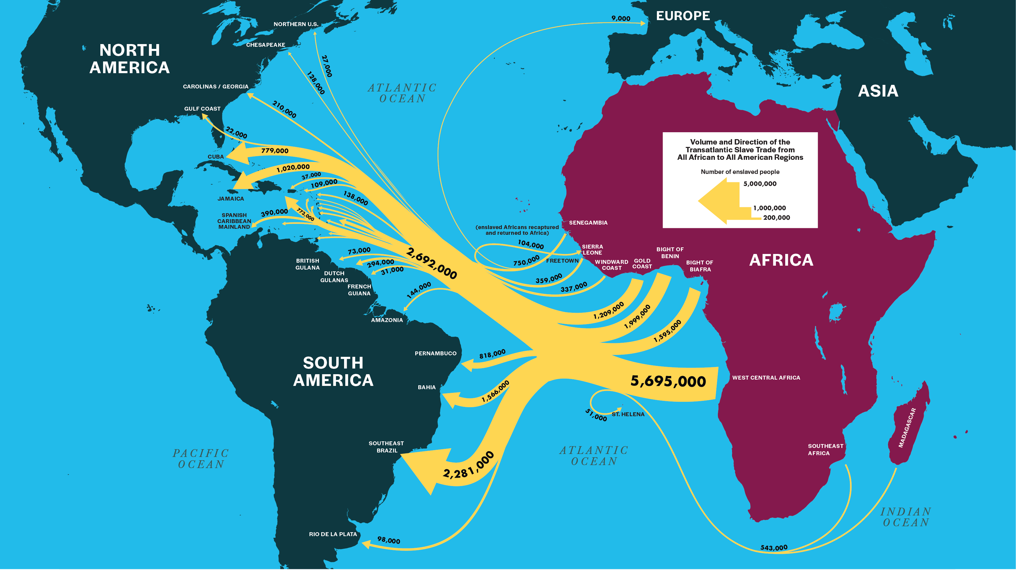
The transatlantic Slave trade

Slide 5
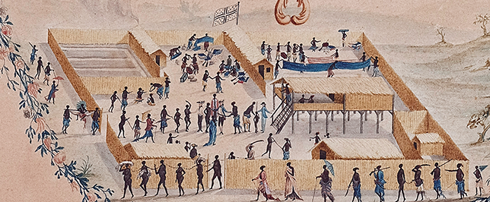
Domestic African Slavery
Slave Trading Compound at Loango, North of the Congo Estuary, 1771 from "Atlantic Cataclysm: Rethinking the Atlantic Slave Trades", David Eltis.

Slide 6

Orlando Patterson (1940-)

Slide 7
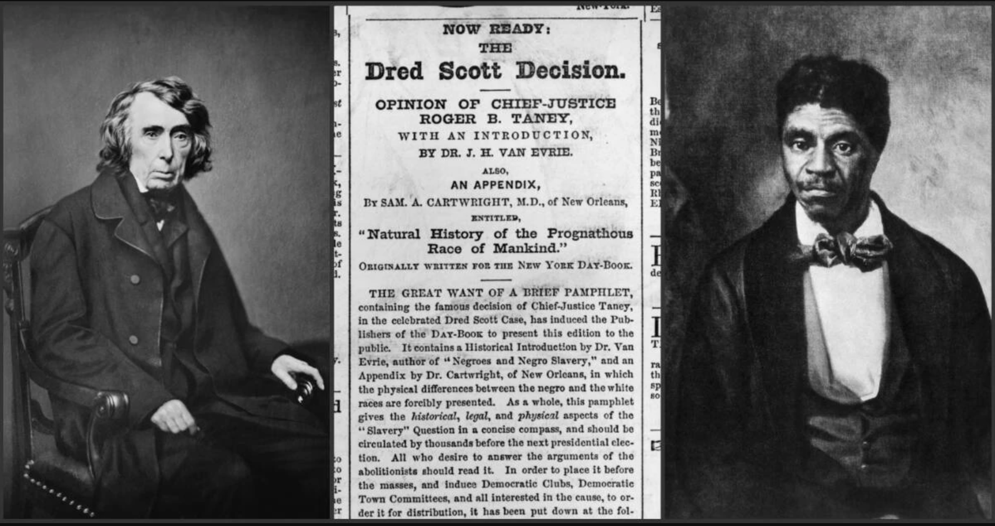

Slide 8
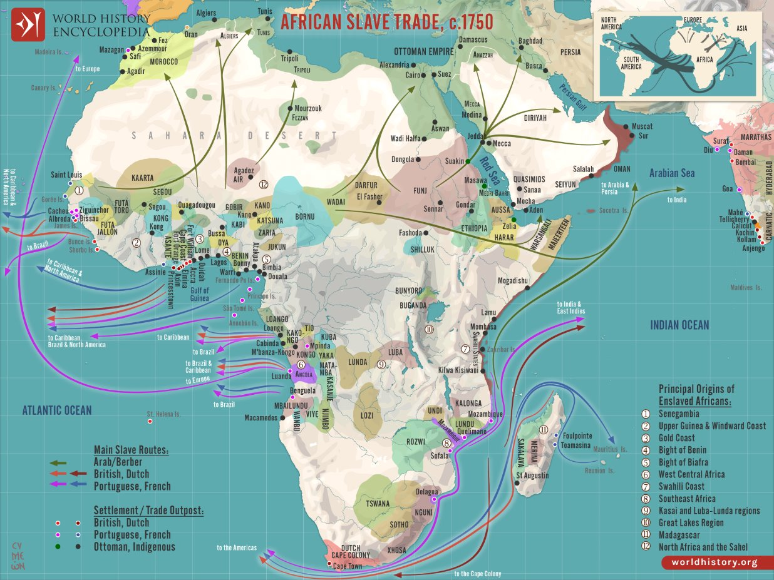

Slide 9
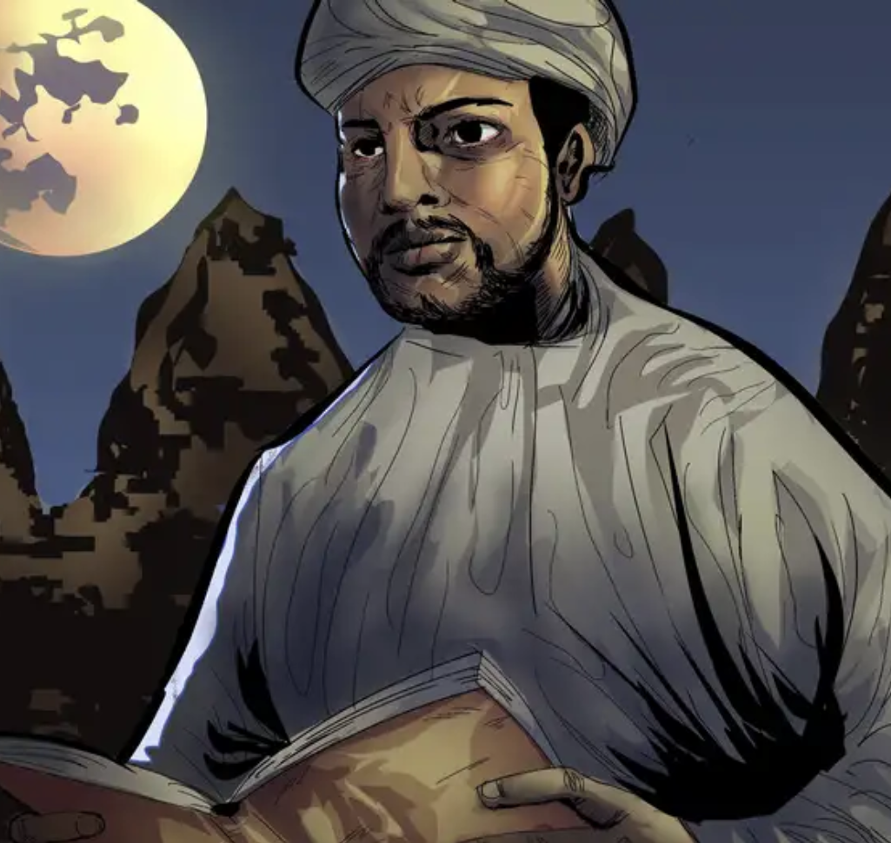
Ahmed Baba

Slide 10
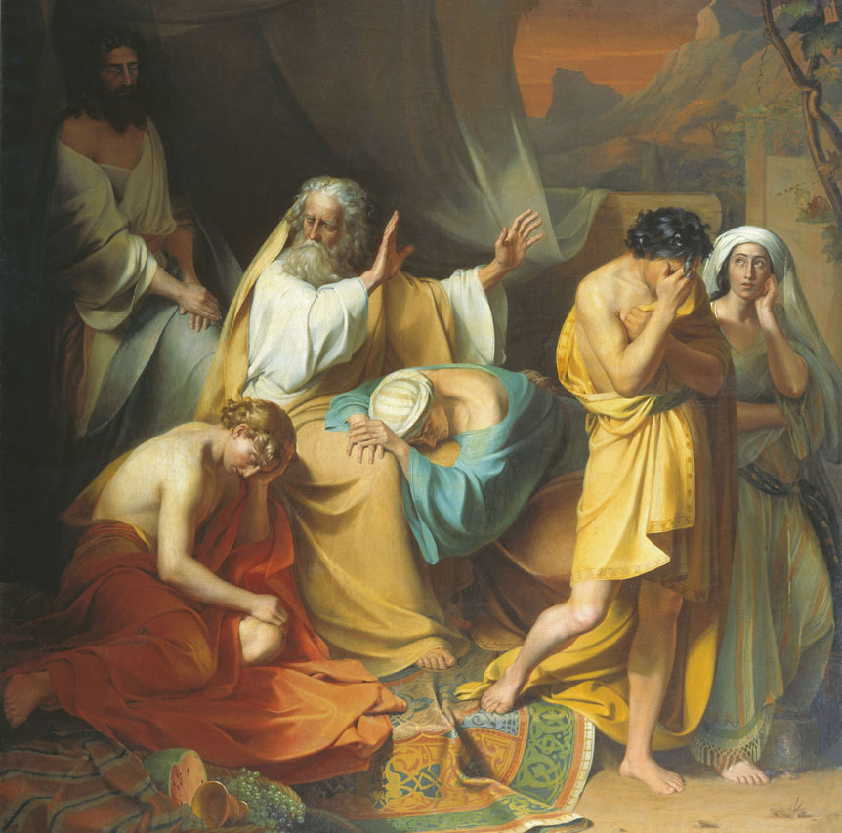
The Hamitic Myth
Noah damning Ham, a 19th-century, Ivan Stepanovitch Ksenofontov

Slide 11
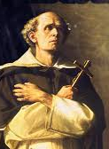
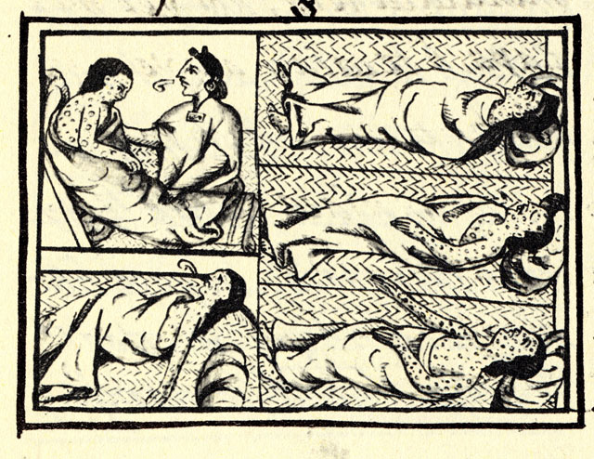
Bartolomé de las Casas
Drawing accompanying text in Book XII of the 16th-century Florentine Codex(1555–1576), showing Nahuas of conquest-era central Mexico with smallpox.

Slide 12
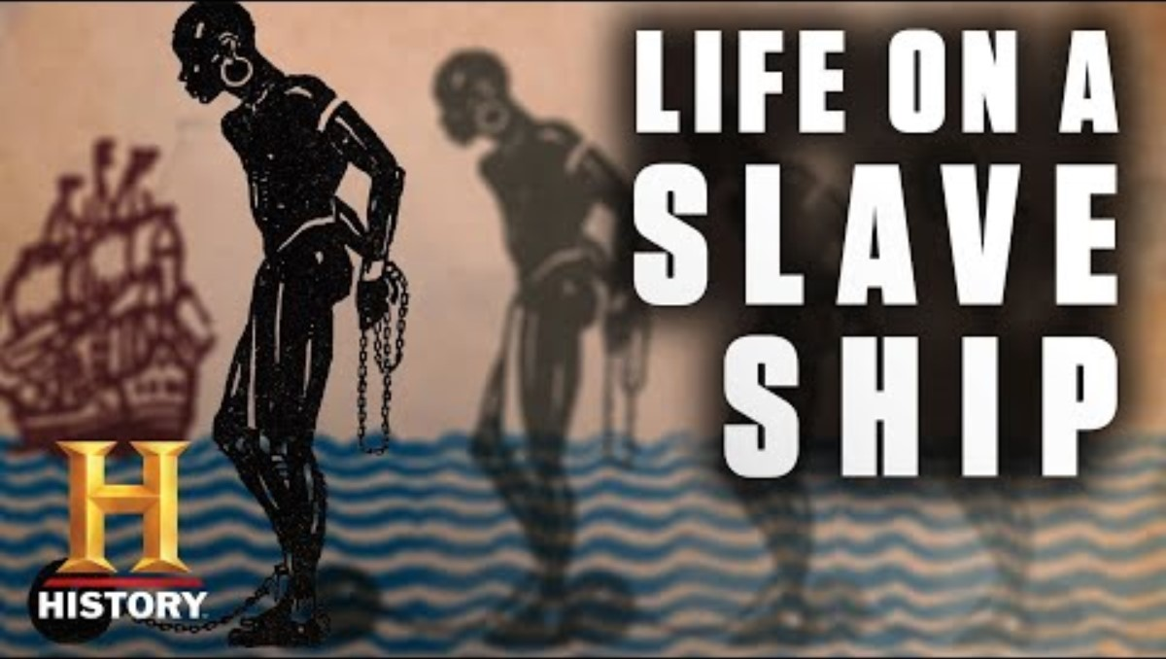

Slide 13
L'Isle de St. Domingue une des Grandes Antilles
Bonne, Rigobert, 1727-1794

Slide 14
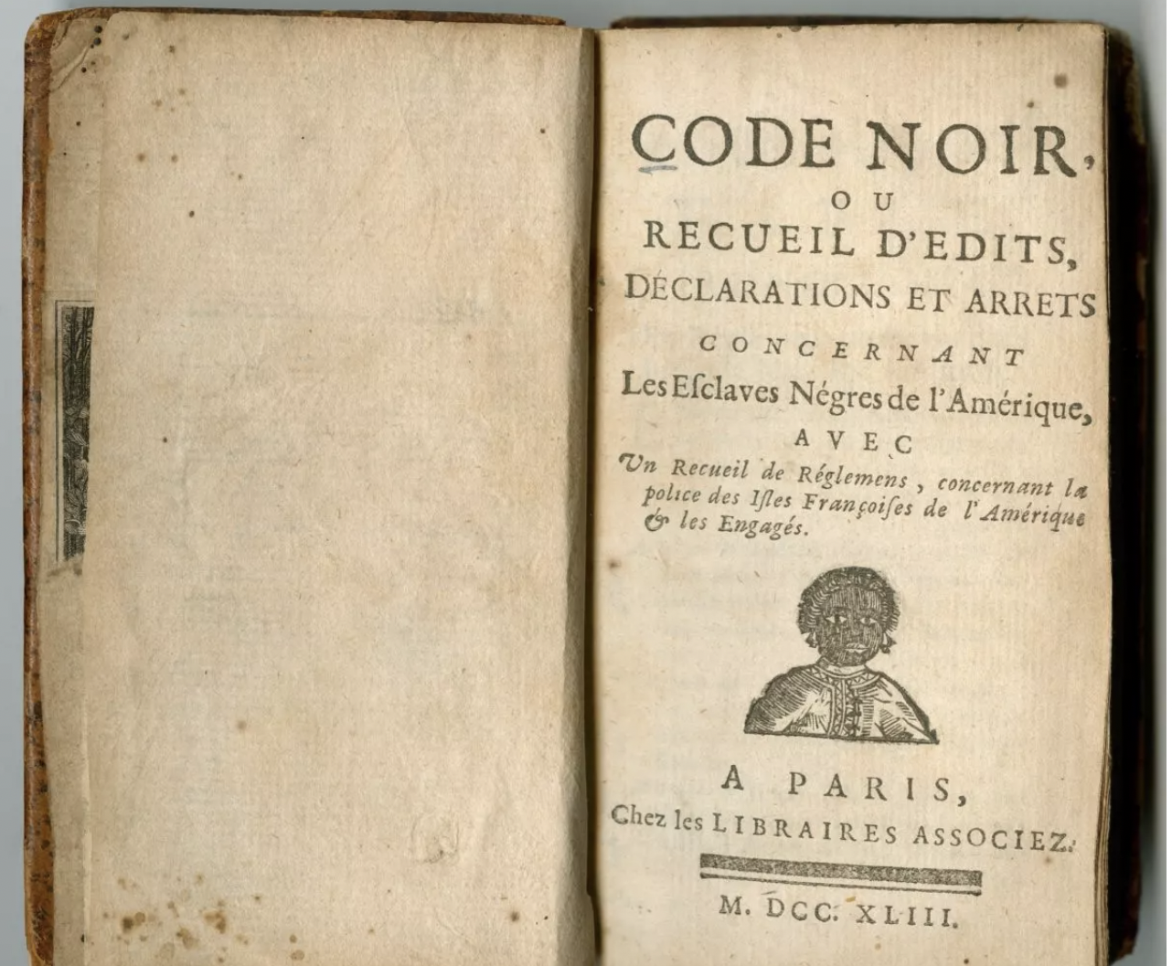


Slide 15
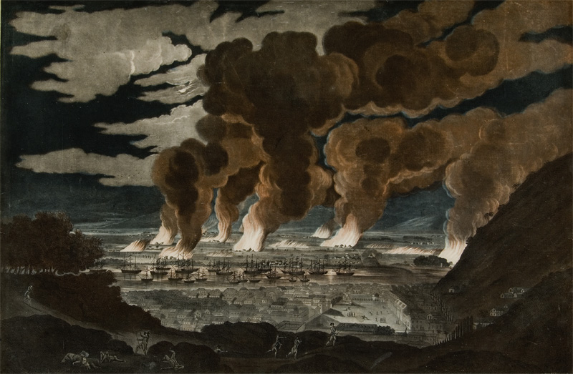
The Haitian Revolution

Slide 16
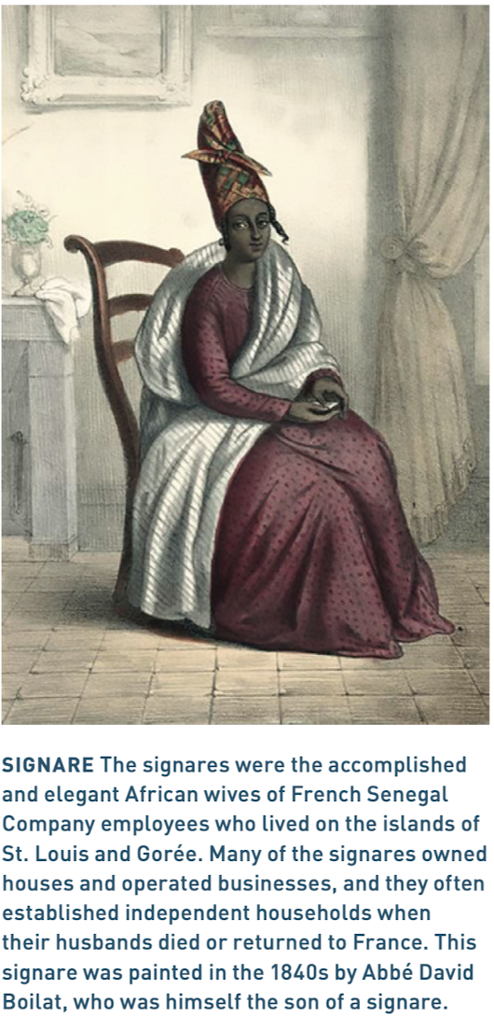
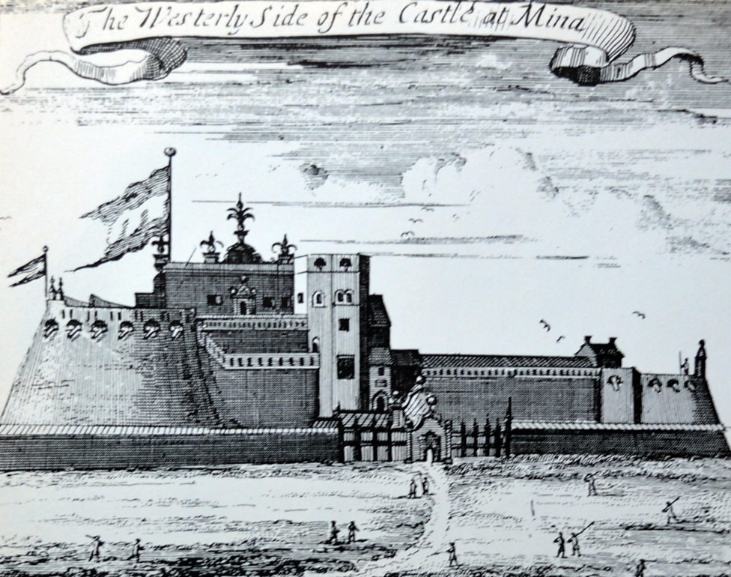
Homegoing, Chapter 1-
Effia

