Slide 1
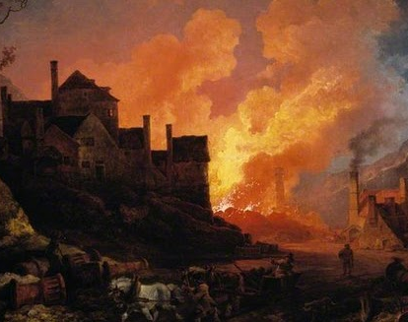

The Great Divergence:
The West and The Rest, Or What makes us modern?
Dr. Luz Cristina Colpa

Slide 2
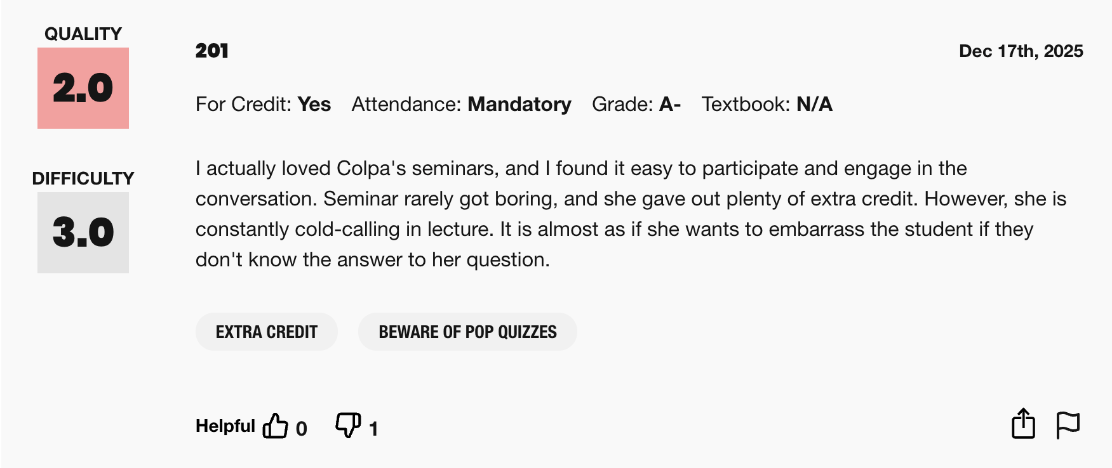
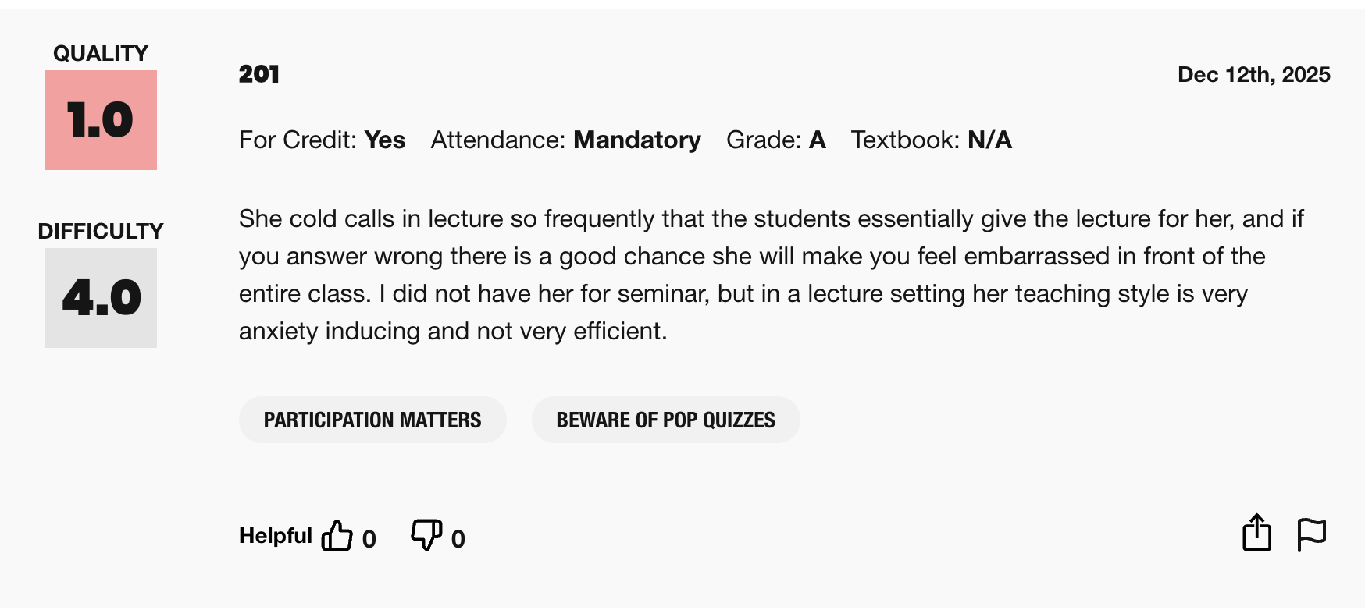

Slide 3
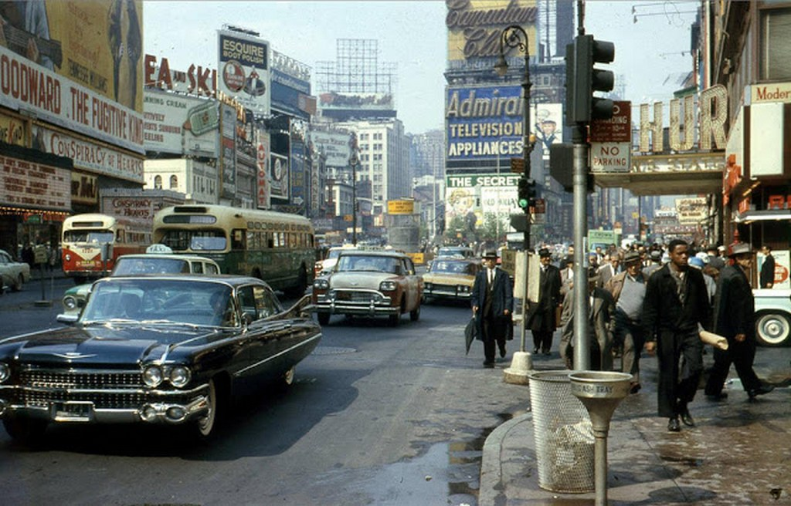
When is modernity?
ThePhoto by PhotoAuthor is licensed under CCYYSA.

Slide 4
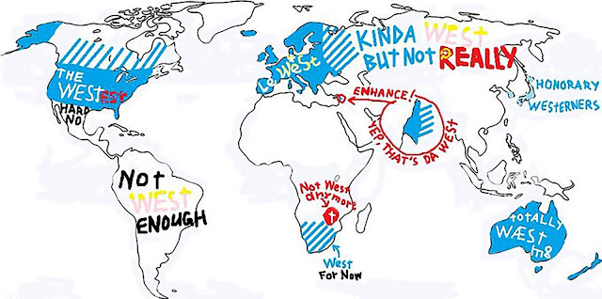

Slide 5
Key Concepts:
The Modern Period
Twin Revolutions Theory
Eric Hobsbawm
Zheng He
The Great Divergence
The Three C's
Kenneth Pommeranz

Slide 6
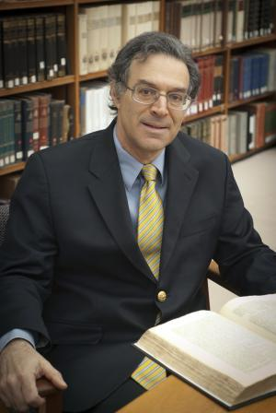
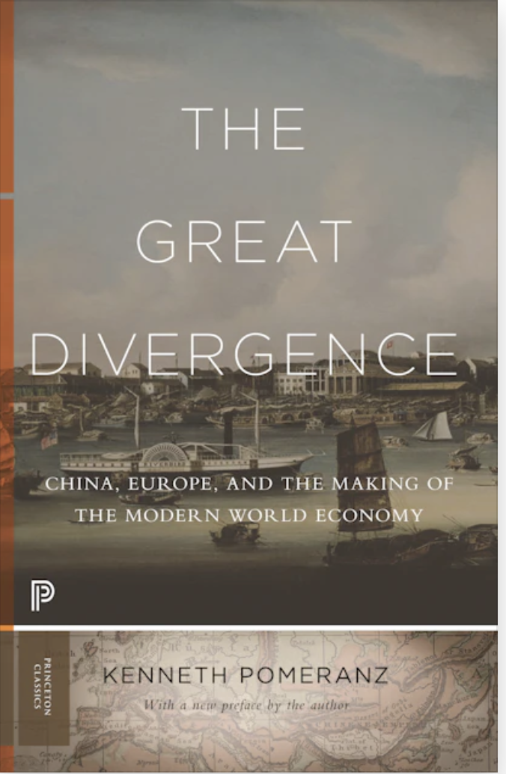
The Great Divergence or the European Miracle?
Kenneth Pomeranz (1958- )

Slide 7
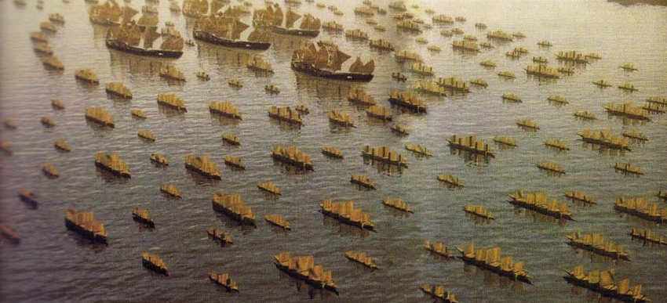
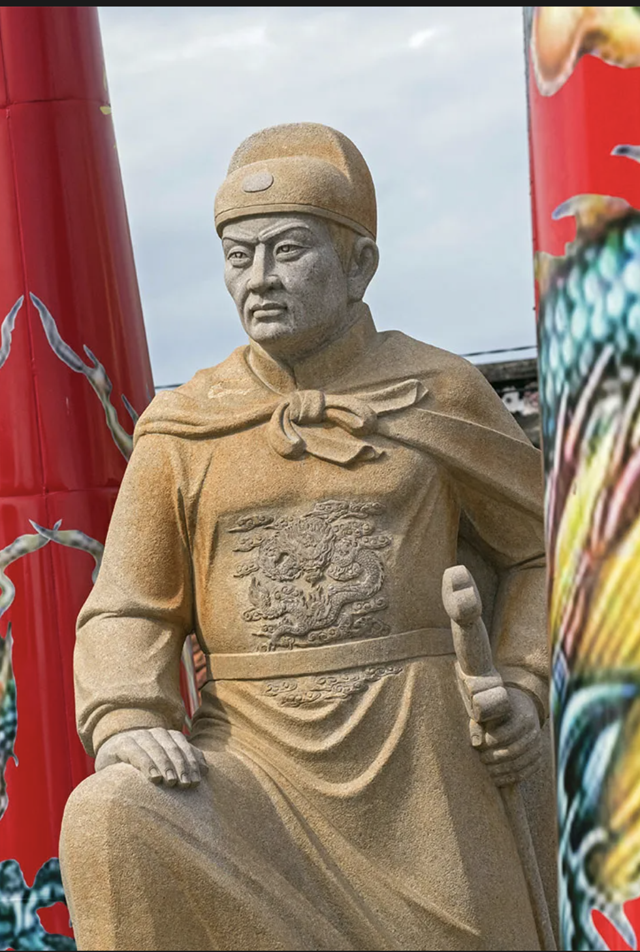
Zheng He
(1371- 1433)
The seven voyages of Zheng He
1405-1433

Slide 8
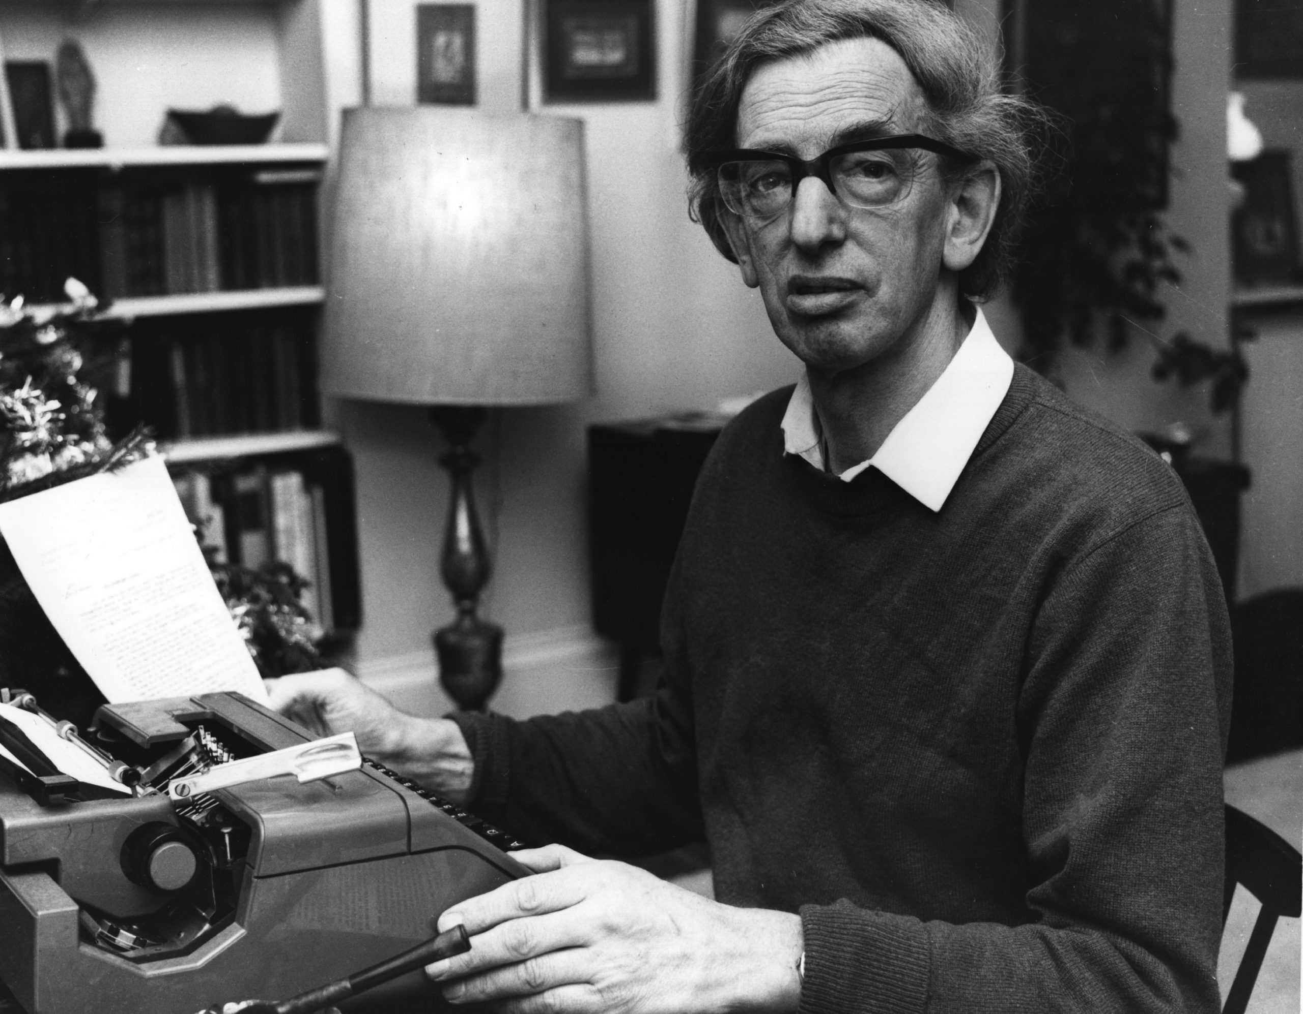
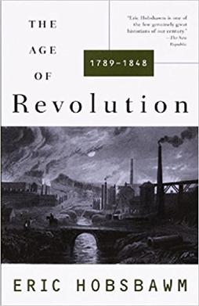
Eric John Ernest Hobsbawm
(1917 – 2012)

Slide 9
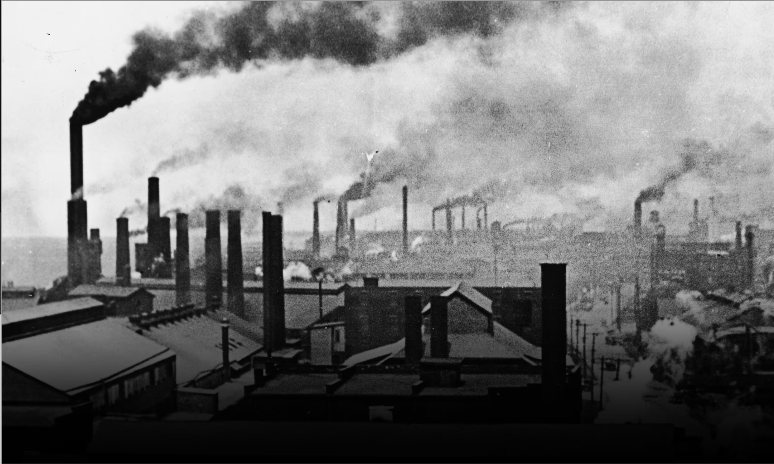
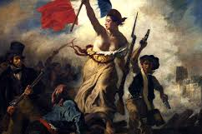
Twin Revolutions Thesis
Modernity & The Twin Revolutions Theory

Slide 10
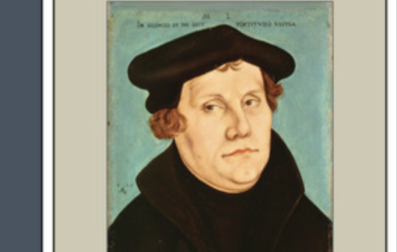
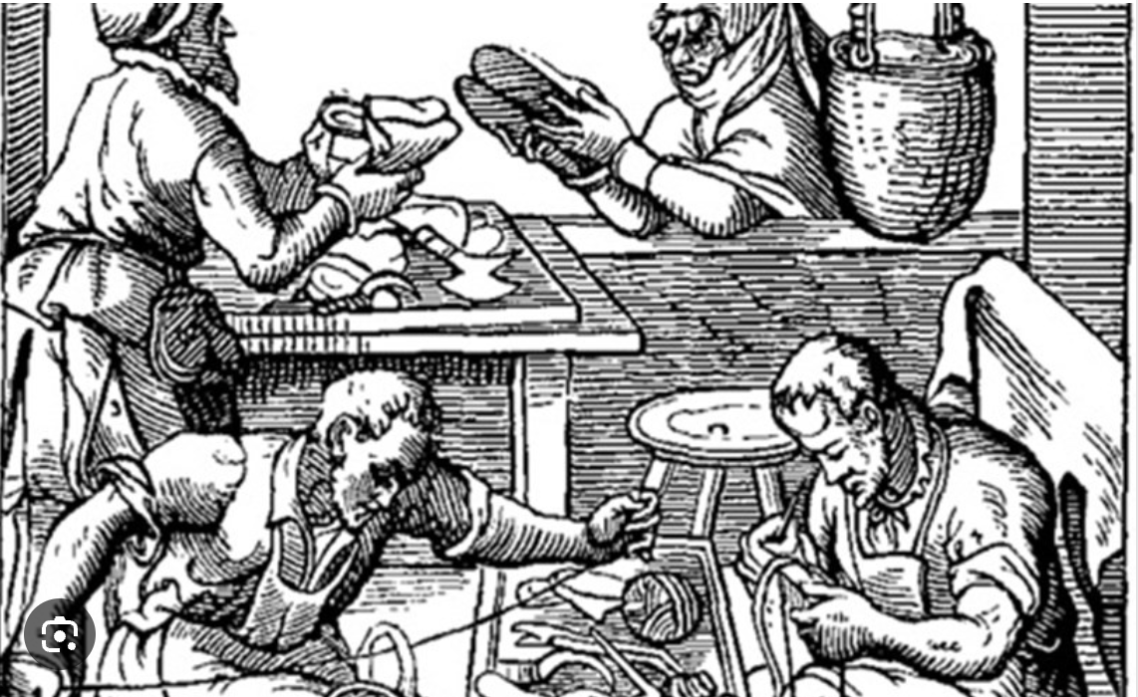
Socio-Cultural
Reasons for the Divergence?

Slide 11
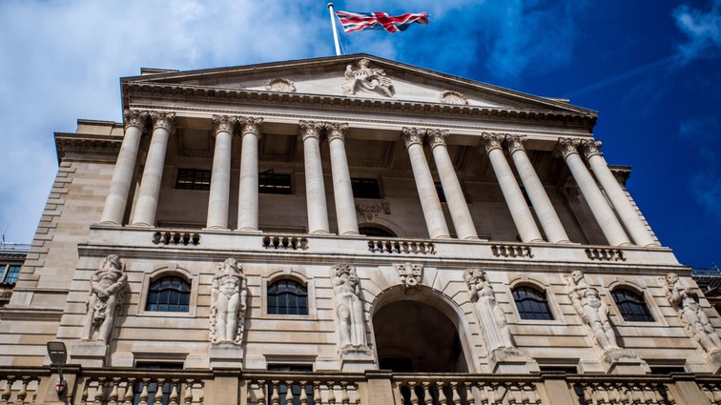
Political and Economic Reasons for the Great Divergence

Slide 12



Personal Incorporation:
Love, thrive, practice LLC.

Slide 13
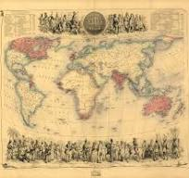
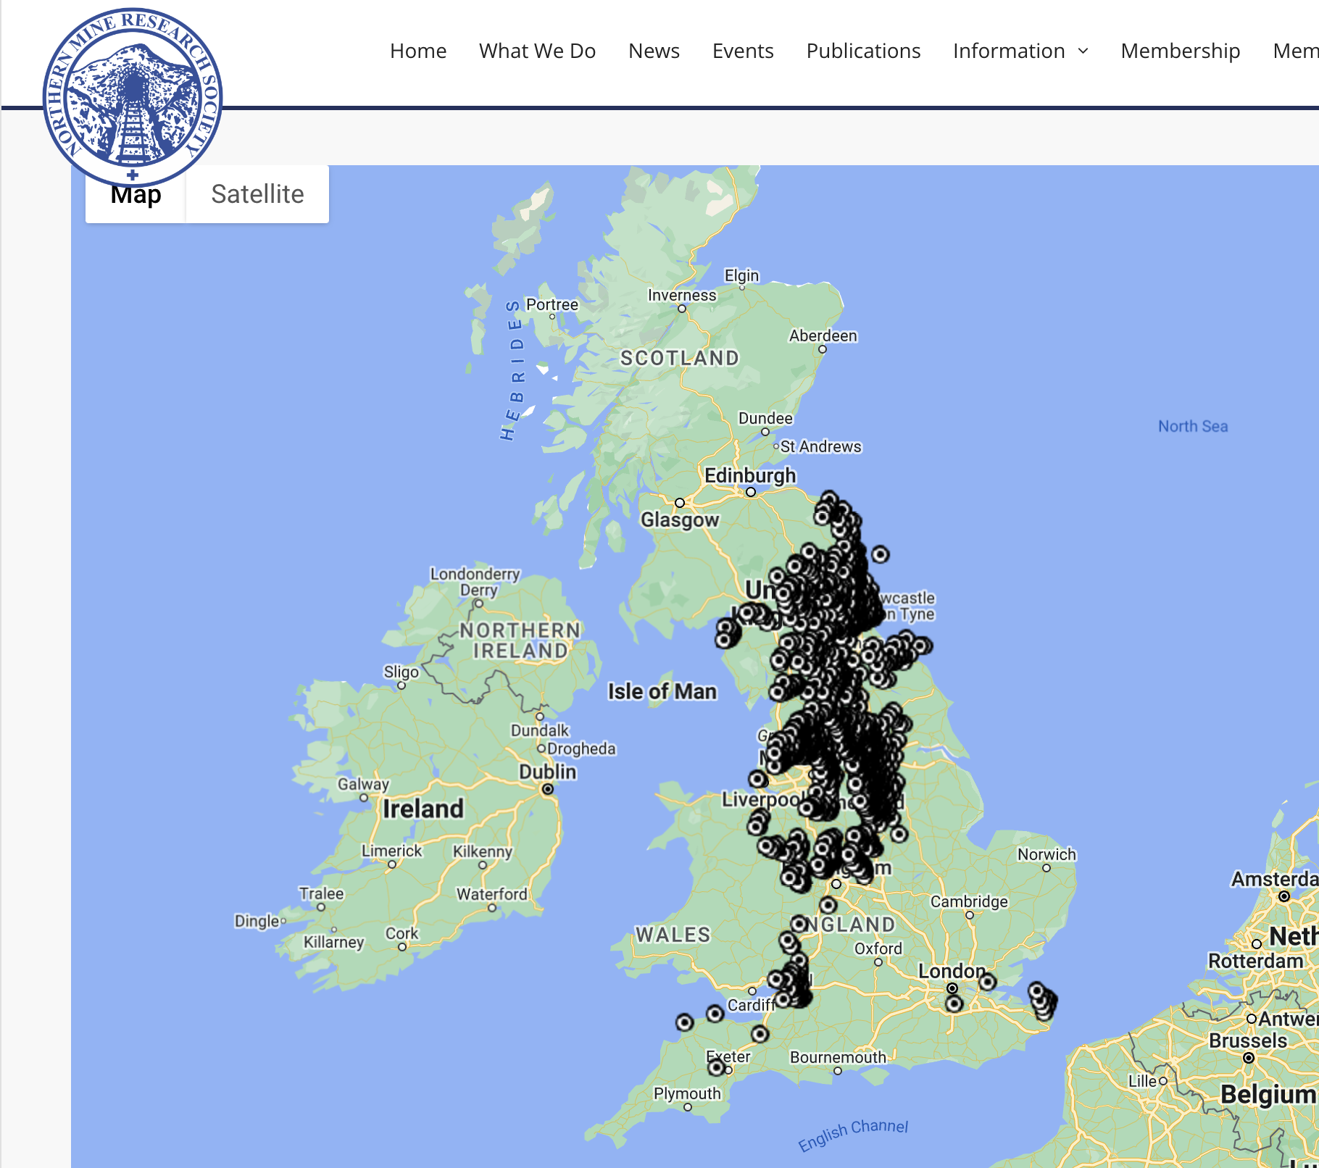

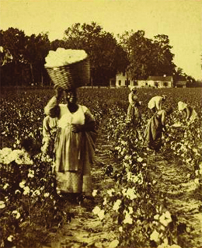
Material Reasons for the Divergence

Slide 14

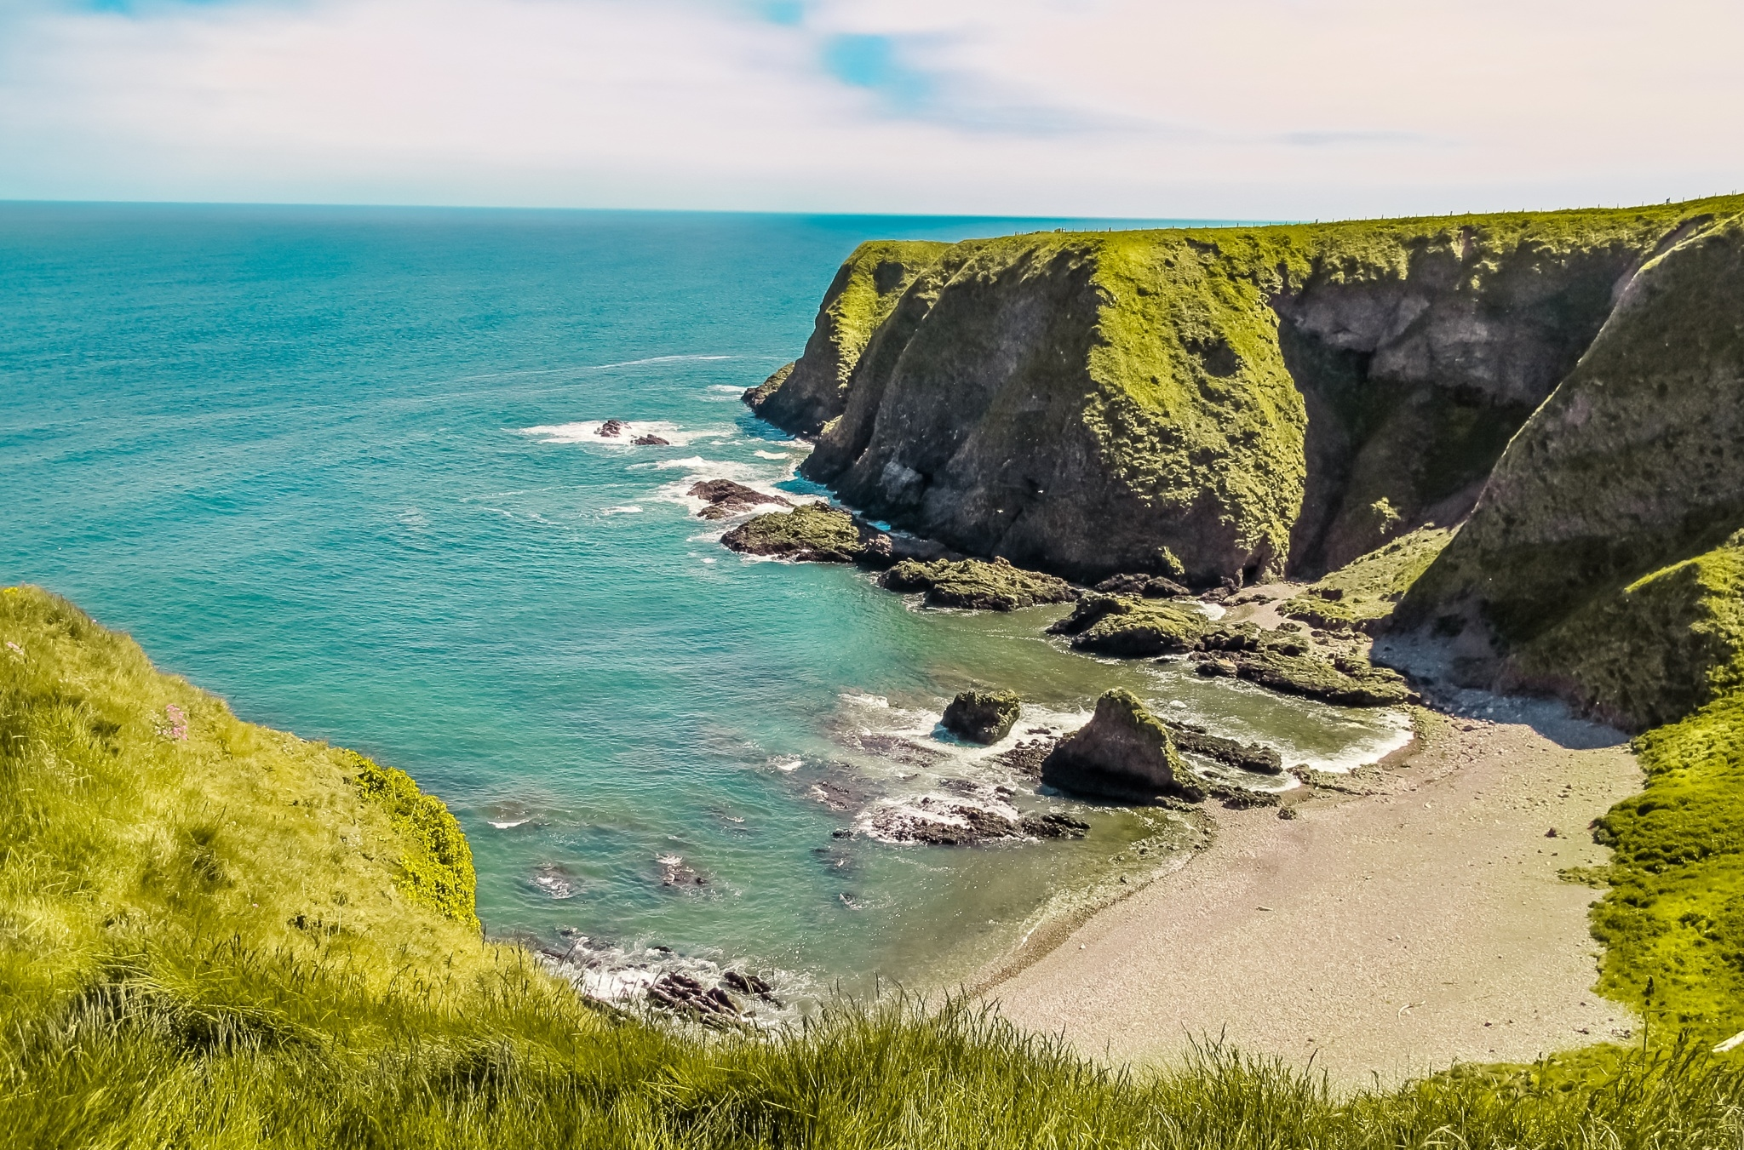
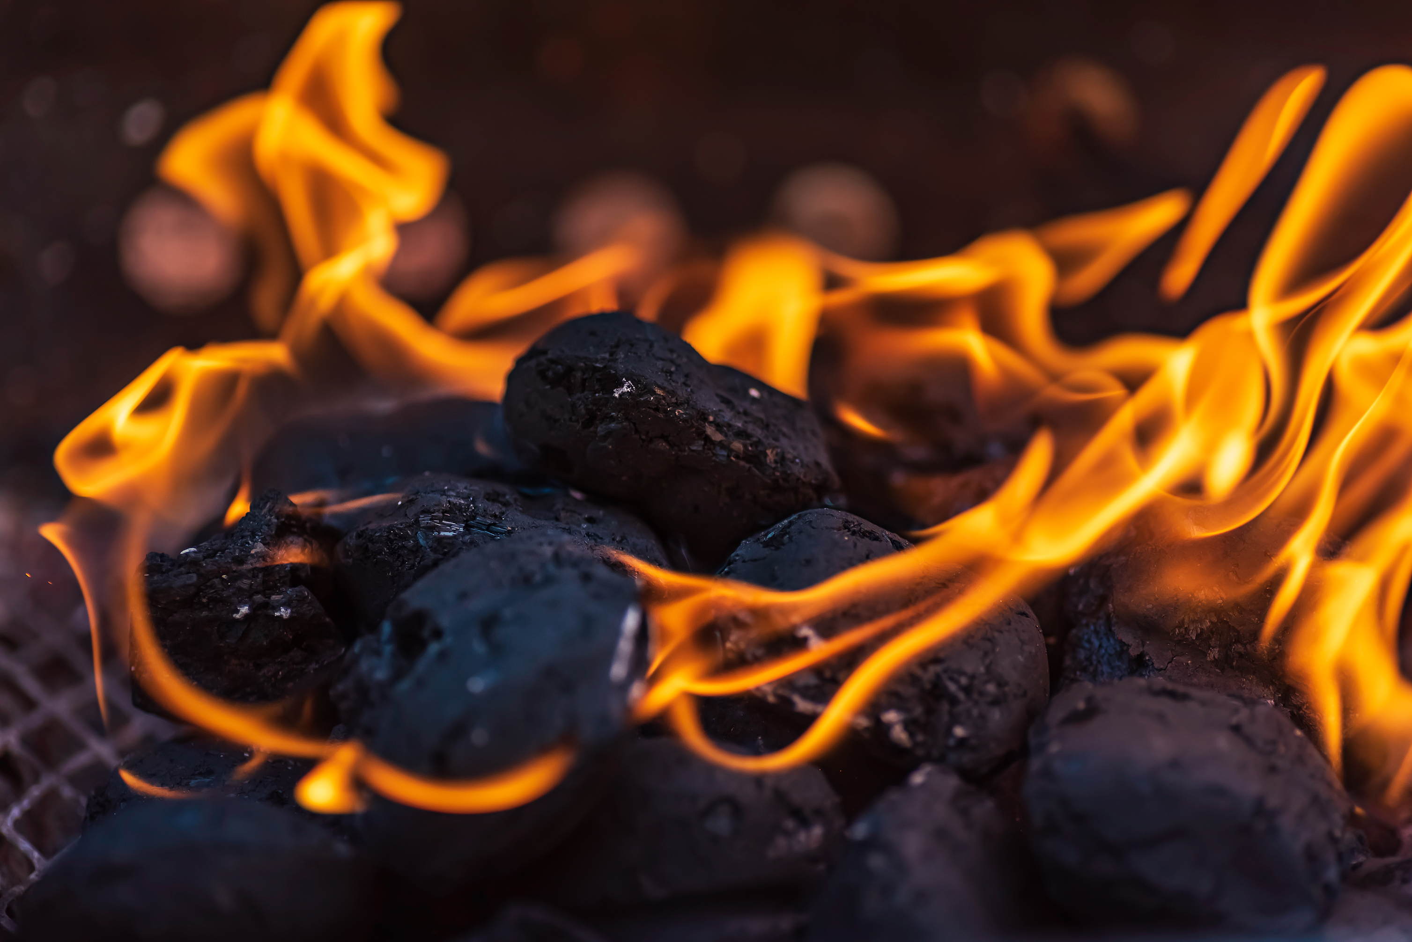
The Three C's
Coal
Colonies
Credit

