Slide 1
Catholicism Confronts Modernity
Dr. Kathleen Cavender-McCoy

Slide 2
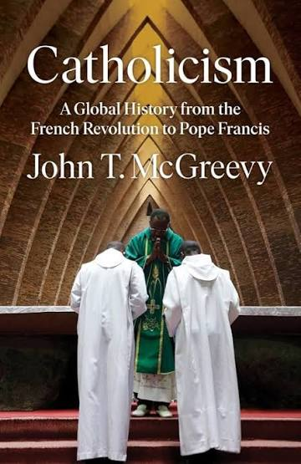
McGreevy Book

Slide 3
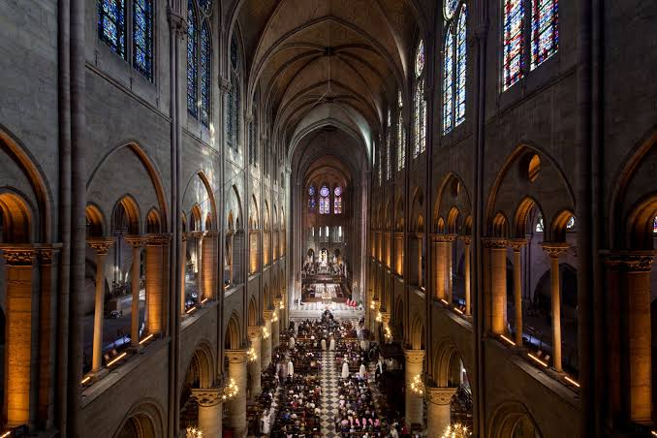
Topics for Today’s Lecture
What is the Church?
How do we understand the Syllabus of Errors?
How did Ultramontanism and Reform Catholicism shape the Church’s response to the French Revolution?

Slide 4
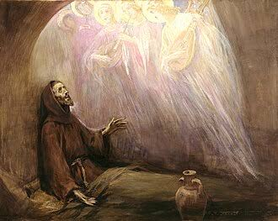
What is the Church?
Mystical Body of Christ- the Church is the Body of Christ. Christ is the Head; the baptized are the members; the Holy Spirit is the soul that animates and unifies it. It is perfect and infallible. Jesus promises “the gates of Hell will not prevail against it.”
Visible, Historical Institution
At the same time, the Church is a visible, hierarchical society in history—organized with the successors of the apostles (bishops in communion with the Bishop of Rome), priests, deacons, and the laity. It has juridical structures, laws (canon law), temporal goods, administrative offices, and cultural expressions that change over time.
This institutional dimension is fallible and imperfect

Slide 5
Mystical Body of Christ
The Church is the Body of Christ. Christ is the Head; the baptized are the members; the Holy Spirit is the soul that animates and unifies it.
In this sense the Church is:
Perfect and holy by virtue of its divine origin, its Head (Christ), its soul (the Holy Spirit), its doctrine (revealed truth), its sacraments (channels of grace), and its ultimate end (communion with God).
Indefectible: it will never fail in its essential mission or lose the deposit of faith.
Infallible in its definitive teaching on faith and morals (when the pope speaks ex cathedra, or the college of bishops teaches in union with him, or the ordinary universal magisterium proposes something as divinely revealed). This infallibility protects the Church from formally teaching error in matters necessary for salvation.
One, holy, catholic, and apostolic (the four marks of the Church recited in the Creed).

Slide 6
Visible, Historical Institution
At the same time, the Church is a visible, hierarchical society in history—organized with the successors of the apostles (bishops in communion with the Bishop of Rome), priests, deacons, and the laity. It has juridical structures, laws (canon law), temporal goods, administrative offices, and cultural expressions that change over time.
This institutional dimension is fallible and imperfect because it is composed of human beings who remain free and capable of sin. Catholic teaching is explicit on this point:
Individual members—popes, bishops, priests, and laypeople—can and do sin, sometimes gravely. Personal sin does not destroy the holiness of the Church as such, but it wounds the Body and obscures its witness.
The Church’s ordinary administration, disciplinary decisions, pastoral strategies, financial management, and prudential judgments are not protected by infallibility. These can be mistaken, imprudent, or even corrupted.
Scandals (clerical sexual abuse, financial misconduct, political compromises, failures of leadership) are real and must be acknowledged. They do not prove that the Church as Mystical Body has failed; they prove that its human members have failed.
Lumen Gentium 8 famously teaches that the Church is a complex reality: “The society structured with hierarchical organs and the Mystical Body of Christ… are not to be considered as two realities, nor are the visible assembly and the spiritual community… Rather they form one complex reality which comes together from a human and a divine element.”

Slide 7
Aspect | Mystical Body of Christ | Visible Historical Institution
Nature | Divine + human; primarily spiritual | Human society with divine origin and mission
Holiness | Intrinsically holy (by Christ and the Spirit) | Holy in its essence, but members are sinners
Teaching authority | Infallible in definitive matters of faith/morals | Ordinary teaching and governance are fallible
Sin and failure | Cannot be destroyed or formally err in dogma | Members and structures can sin, err, and fail
Continuity | Indefectible until the end of time | Subject to reform, purification, and historical change

Slide 8
How to think about the Syllabus of Errors
Historical contingency → Dogma, Doctrine, and changeable teachings
Doctor of the Church John Henry Newman
Newman defends the Syllabus against Protestant and liberal Protestant attacks (especially Gladstone’s) by carefully limiting its formal authority while upholding the underlying papal teachings it indexes. He treats it as an administrative/pastoral digest rather than a new act of the ordinary or extraordinary Magisterium.

Slide 9
Nature of the Document
The Syllabus is not a dogmatic or infallible papal act. It is simply a collection (or “index raisonné” / table of contents) of 80 erroneous propositions that Pius IX had already condemned in various earlier Allocutions, Encyclicals, and other documents.
Newman stresses that it contains “not a word… of the Pope’s own writing” beyond the heading and the references to the original sources. It was compiled anonymously (likely by a theologian or official) and sent to the bishops by Cardinal Antonelli (the Pope’s Secretary of State) at the Pope’s direction, along with the Encyclical Quanta Cura.

Slide 10
Authority and Reception of the Document
Catholics are to receive it with “profound submission” and an act of obedience, but not with the assent of faith (de fide). It has only “indirect extrinsic sanction” from the Pope. It is neither official (not signed or sealed by the Pope in the usual way), personal, nor immediate.
Newman insists the Pope cannot delegate his Magisterium; only the Pope speaking officially, personally, and immediately binds in matters of faith and morals.

Slide 11
Proper Interpretation
The true meaning and force of any condemnation can be known only by consulting the original documents to which the Syllabus refers.
The wording of the Syllabus itself is not an exact transcript of the Pope’s words and must not be treated as such.
Gladstone’s claim that the Encyclical Quanta Cura infallibly condemns everything listed in the Syllabus is rejected by Newman as “untenable” and “marvellously unfair.”

Slide 12
Practical Use of the Syllabus
The Syllabus functions as a helpful reference tool for bishops, reminding them of errors the Pope had already noted. It does not create new obligations beyond those already present in the cited sources. Newman notes that some near the Pope had wanted a stronger, formal document with graded theological censures (e.g., “heretical,” “false”), but the Pope did not issue one of that kind.

Slide 13
Aspect | Syllabus of Errors (1864) | Vatican II (1962–65)
Tone toward modernity | Hostile / defensive rejection | Dialogical / positive engagement (aggiornamento)
Religious liberty | Condemns liberal versions; “error has no rights” | Affirms civil right to immunity from coercion
Church-State | Ideal of confessional Catholic state | Accepts pluralism; proper autonomy of the temporal order
Other religions | Strong anti-indifferentism | Positive elements recognized; ecumenism encouraged
Method | List of condemned propositions | Pastoral constitutions & declarations

Slide 14
Official Catholic interpretation (especially under the “hermeneutic of continuity” emphasized by Benedict XVI) holds that Vatican II develops rather than contradicts the earlier teaching, distinguishing the contexts and precise meanings of the terms involved.

Slide 15
Catholicism Confronts Modernity

Slide 16
Two Catholic Visions
Reform Catholicism (a broad term encompassing Enlightenment Catholicism, Gallicanism, Jansenist currents, Richerism, and conciliarist traditions): more open to reason, science, local episcopal or even lay authority, simplified piety, and, in some cases, republican or constitutional politics.
Ultramontanism (“over the mountains” to Rome): centered on papal authority, hierarchical discipline, rich popular devotions, miracles, religious orders, and a global, transnational identity that resisted subordination to the nation-state.
Notes:
McGreevy begins not in the distant past but at a rupture that, he argues, was the most disruptive event in modern Catholic history until the Second Vatican Council: the French Revolution and the Napoleonic wars that followed.
Until then, Catholicism had been deeply entangled with the old regime of throne and altar across much of Europe and its empires. Modernity—Enlightenment ideals of reason, individual rights, popular sovereignty, secular states, and national citizenship—arrived not as a gentle conversation but as a cataclysm. McGreevy frames the ensuing two centuries as a contest between two enduring Catholic visions of how to respond:
Reform Catholicism (a broad term encompassing Enlightenment Catholicism, Gallicanism, Jansenist currents, Richerism, and conciliarist traditions): more open to reason, science, local episcopal or even lay authority, simplified piety, and, in some cases, republican or constitutional politics.
Ultramontanism (“over the mountains” to Rome): centered on papal authority, hierarchical discipline, rich popular devotions, miracles, religious orders, and a global, transnational identity that resisted subordination to the nation-state.
These are not airtight camps; individuals and movements crossed lines. But the tension between them drives the story of Chapters 1–3 and, in McGreevy’s larger argument, of modern Catholicism itself. The Church would both resist and adapt to modernity, surviving trauma by reinventing itself as a more centralized, devotional, missionary, and institutionally dense global body.

Slide 17
Aspect | Ultramontanism | Reform Catholicism
Papal authority | Strong emphasis on supremacy and centralization in Rome | More critical of excessive papal/hierarchical centralization; favored greater local or lay roles
Attitude to modernity | Often resistant or defensive against liberalism, secularism, and modern ideas | Sought positive engagement with modern science, culture, history, and progress
Church structure | Hierarchical, Roman-centered | Desired more openness, less authoritarianism, adaptation of practices
Overall orientation | Traditional, integral, papal loyalty | Reformist, adaptive, critical of rigidity while remaining Catholic

Slide 18
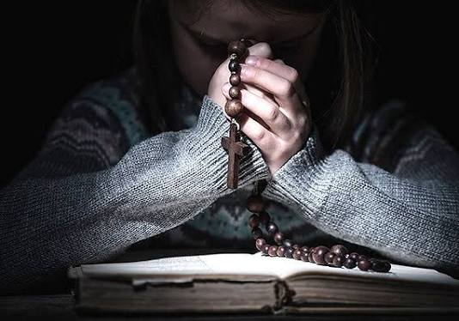

Slide 19
The State of the Question, from McGreevy
The Ultramontane Revival shaped every dimension of Catholic life from the early 19th century through the 1960s.
The disarray caused by the French Revolution allowed ultramontanism to become the dominant form of Catholicism
This revival began with hearts, not minds
Focus on miracles
Lower-class believers

